Slide 1
A Year of Storytimes
Week 3
Sound of the Week:
t for tennis
Download the actions: http://jollylearning.co.uk/gallery/jolly-phonics-actions/

Slide 2
Sample Library Preschool Storytime: t for tennis!
This is a sample storytime for librarian learning and planning purposes. It is not a script; it is a case study. It is not meant to be prescriptive, nor to be memorised word-for-word. By all means, replicate some or all of the session plan’s bones (books, songs, games, props), but put your own spin on it!
This session incorporates evidence-based literacy techniques, and is designed to empower both children, and parents in particular, with practically-modelled strategies to use at home, both now, and also well into the school years, when the children start bringing readers home.
It has been developed with the best of whole-language and phonics approaches in mind, and balances explicit phonemic awareness and reading games with high-quality, rich dialogic and immersive literature engagement.
See elsewhere on the website for the foundational research base behind this session, and for a video modelling and explaining the choices in action: www.earlylearningcontinuum.com.au.

Slide 3
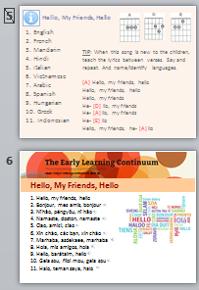
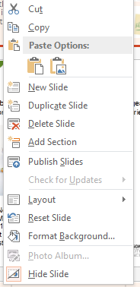
Parent Handout
Slides 4 & 5 are hidden and will not play in the presentation. (Same goes for these info slides.)
Print slides 4 & 5 back-to-back for a one-sheet (double-sided) parent handout.
Encourage the families to stick the speech sound cloud on the wall at home, or stick it in a special scrapbook for when their children are learning to read.
Some other bird-related songs by Nancy Stewart that you may want to add, depending on the age of your cohort, to link to book 2:
  http://www.nancymusic.com/Elbowplay.htm
  http://www.nancymusic.com/Crowplay.htm
  http://www.nancymusic.com/SOM/2007/There_was_a_tree.htm
  http://www.nancymusic.com/SOM/2009/bluebird-through-my-window.htm
  http://www.nancymusic.com/Flybirdplay.htm
↑ Hidden slides look pale, and have a strike through their number.
Right click to select either public or hidden page layouts for new slides.

Slide 4

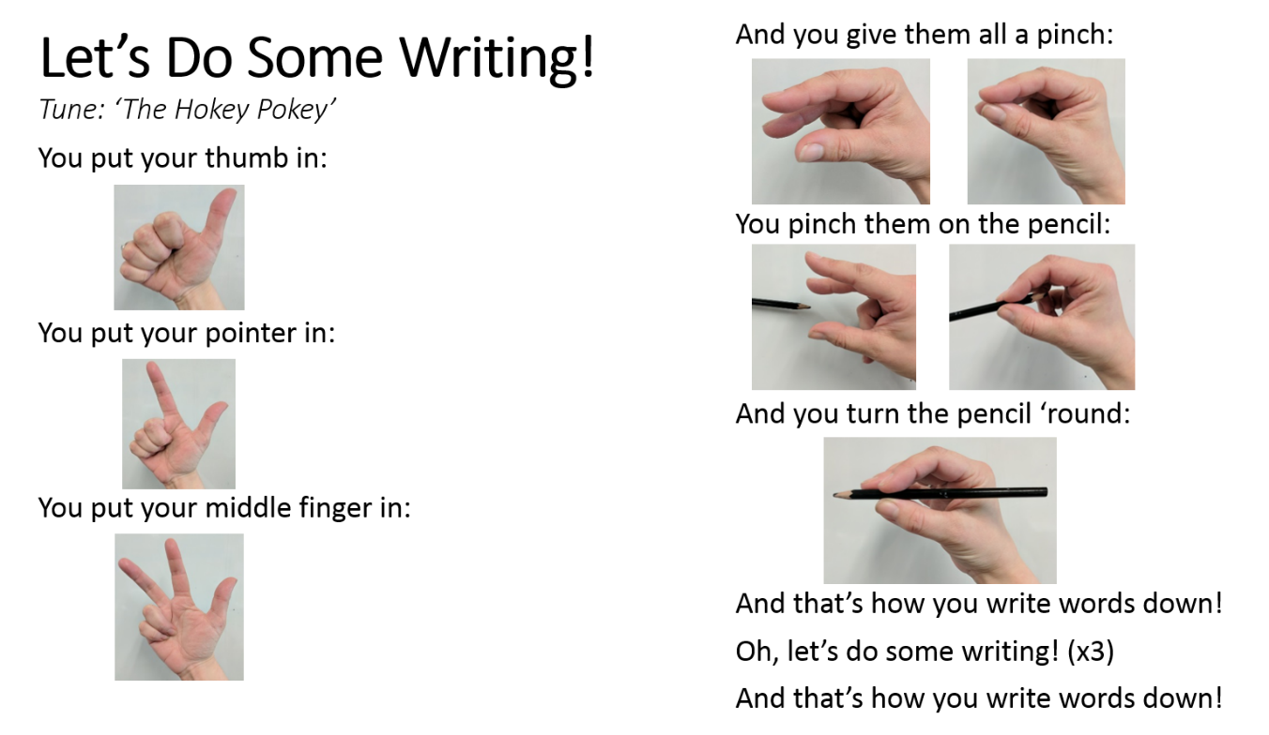
Storytime Sound of the Week: Useful Resource Links:
Download the free Jolly Phonics Parent and Teacher Guide: http://jollylearning.co.uk/parent-teacher-guide/
Download the free Jolly Phonics Actions Sheet: http://jollylearning.co.uk/gallery/jolly-phonics-actions/
Buy the Jolly Songs book and CD at https://dominie.com.au/products/JL-695
Purchase and download the Jolly Songs album on:
- iTunes: https://itunes.apple.com/us/album/jolly-songs-in-british-english/935294825
- Google Play (as an app): https://play.google.com/store/apps/details?id=com.jollylearning.jollysongs
Listen to the Jolly Songs on YouTube: https://youtu.be/ByPW0xDpsnE
Download various Jolly Learning interactive literacy apps on your:
- iPhone or iPad: https://itunes.apple.com/us/developer/jolly-learning/id897894555?mt=8
- Android phone or tablet: https://play.google.com/store/apps/dev?id=8325657000152317866
Over 200 free children’s songs, downloadable as mp3s: www.nancymusic.com and www.singwithourkids.com
Free downloadable online readers from SPELD SA: http://www.speld-sa.org.au/services/phonic-books.html
Visit www.earlylearningcontinuum.com.au for free Reading Games (interactive readers), songs, books, videos, and information for parents.
YouTube channels for carers to learn more:
- Miss Emma, The Reading Whisperer: https://www.youtube.com/channel/UCbsjRiM-Z-Bjk20wzF-MOUw
- Sarah Librarian’s Jolly Phonics playlist: https://www.youtube.com/playlist?list=PL7CWH34MqRng86RWj7Fpsp0Y1ZH9RKmJP
https://www.speechsoundpics.com/speech-sound-detectives
Be speech sound picture (SSP) detectives!

Slide 5
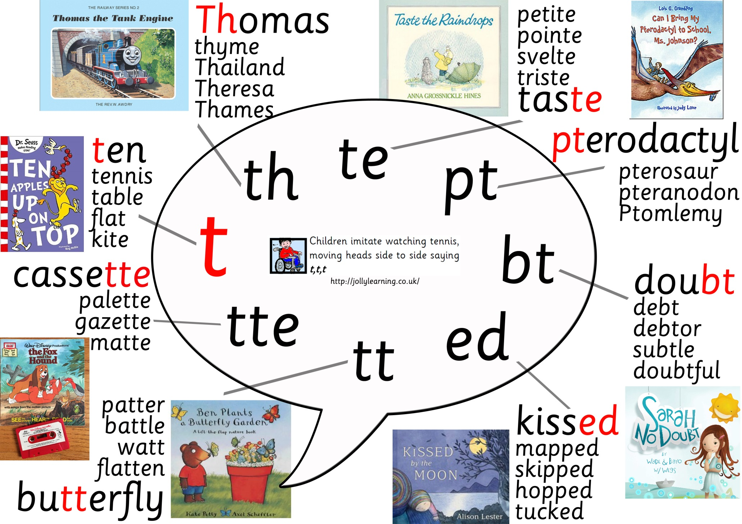
Speech Bubble for t

Slide 6
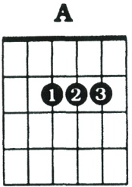
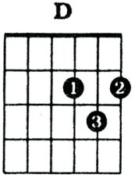
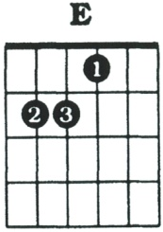
Hello, My Friends, Hello
English
French
Mandarin
Hindi
Italian
Vietnamese
Arabic
Spanish
Hungarian
Greek
Indonesian
Alternative Hello Songs
TIP: When this song is new to the children, teach the lyrics between verses. Say and repeat. And name/identify languages.
[A] Hello, my friends, hello
Hello, my friends, hello
Hello, my friends
He- [D] llo, my friends
He- [A] llo, my friends
He- [E] llo
Hello, my friends, he- [A] llo

Slide 7
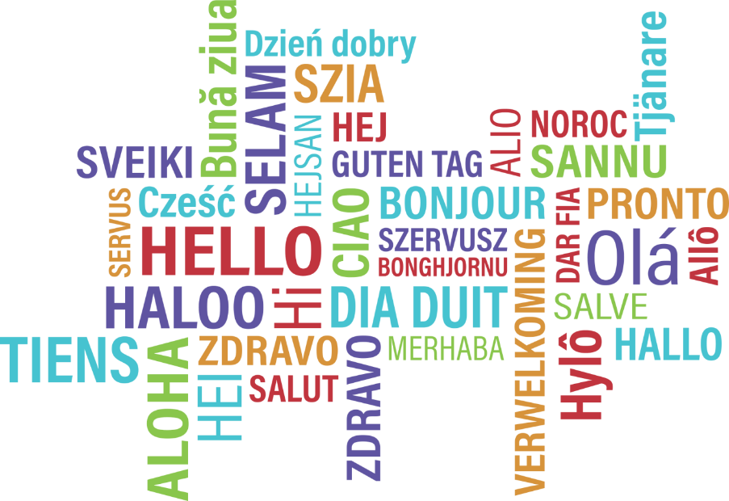

Hello, My Friends, Hello
1. Hello, my friends, hello
2. Bonjour, mes amis, bonjour
3. Nǐ hǎo, péngyǒu, nǐ hǎo
4. Namaste, doston, namaste
5. Ciao, amici, ciao
6. Xin chào, các bạn, xin chào
7. Marhabaan, asdekaee, marhabaan
8. Hola, mis amigos, hola
9. Hello, barátaim, hello
10. Geia sou, fíloi mou, geia sou
11. Halo, teman saya, halo

Slide 8
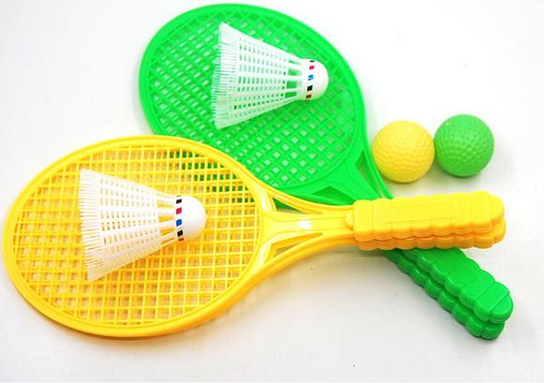
Introduce Jolly Song Scenario
For example:
Point to the picture: “what’s this?” If no one knows, tell them about tennis. Act it out. Mime a serve, etc.
Use props where possible, to bring it alive. Count how many time you can hit the ball up with the racquet without dropping it. The kids will get on board to support and count with you!
“Can you pretend you’re watching the ball go back and forth, over the net? Every time the ball hits the racquet, it makes a t, t, t, t sound. [Do action with them.] T, t, t, t, t, t!”
Segue to song.
Repeat song for learning and memory retention.
Buy the Jolly Songs on Google Play or iTunes, and then embed the mp3 in this presentation by going to Insert >> Audio >> From File/On My PC. Embed the audio into a duplicated lyrics slide, and set playback to “automatically” (instead of “on click”). When you click “next”, nothing will change on the screen, but the audio will start playing. (See Ridin' Along and Singin' a Song slides, below, for demonstration.)

Slide 9
Jolly Phonics Songs
(Tune: The Muffin Man)
When I watch the tennis game
t, t, t
t, t, t
When I watch the tennis game
My head goes back and forth
Download the actions: http://jollylearning.co.uk/gallery/jolly-phonics-actions/

Slide 10
Sound of the Day: /t/
Slide is animated: Text and camera will appear first. Clicking “next” will make the first t appear, and clicking “next” again will reveal the t with the tennis-themed prompts.
With just the camera on screen: “If we were to take a picture of the t-t-t-tennis sound, what would it look like?”
Get out camera prop—they LOVE this. Let them hear the clicking sound. Get them to pretend to hold up an imaginary camera and say, “click!”
Press NEXT, after playing with cameras, to reveal picture of the /t/ sound.
Next again will reveal the picture with memory prompts.
“When you want to write down the /t/ sound, that’s how you can draw a picture of it.”

Slide 11
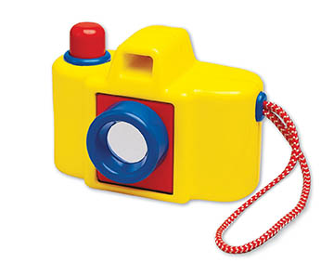




Sound of the Day: t
What would a picture of the t sound look like?

Slide 12
Pencil Grip Song: Let’s Do Some Writing!
“Let’s make sure we’re holding our pencils just right so we can draw a beautiful picture of the t-t-t-t sound in the air.”
With smaller groups, you could hand out a pencil or crayon for the kids to hold. It’s not necessary, though; they can imagine. The important thing is that they’re practicing pencil grasp—the pinch or tripod grip.
Use a pencil yourself, however, so you’re demonstrating fully how the carers and kids can use the song at home to get their grip just right.
MAKE SURE YOU DRAW THE LETTER BACKWARDS IN THE AIR!!! They will mirror whatever you do. You might remember your ballet teacher doing this when you were little: when you face them, use your left for their right/your right for their left.

Slide 13
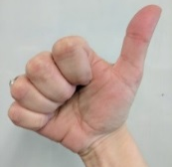
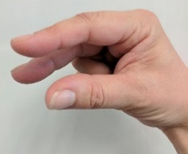
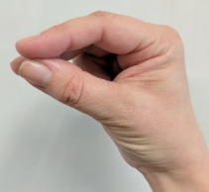
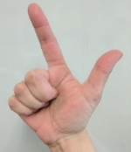
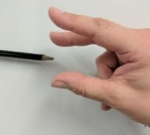
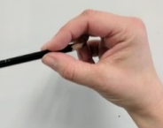
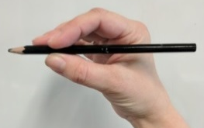
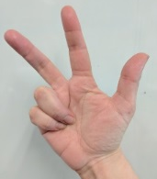
Let’s Do Some Writing! (Tune: The Hokey Pokey)
You put your thumb in:
You put your pointer in:
You put your middle finger in:
And you give them all a pinch:
You pinch them on the pencil:
And you turn the pencil ‘round:
And that’s how you write words down!
Oh, let’s do some writing! (x3)
And that’s how you write words down!

Slide 14
Letter Formation for Sound of the Day
“Let’s practice writing the t-t-t-t sound with our pinchy pencil fingers.”
“Down the racquet, hit the ball, across the net.”
Practice multiple times. Make a big fuss about how beautiful their /t/ pictures look in the air, and what wonderful writers they’re becoming.

Slide 15
Letter Formation

Slide 16
Info for Parents: Setting Up Future Spelling Choices*
“There are actually some other ways to picture the t-t-t-t sound. When you’re older and at school, and you’re super-duper readers, you will be able to read and write AAAALLLLLLL THEEEESE [point around the bubble] pictures of the t-t-t-t sound. Isn’t that amazing? But today, we’re just looking at the main picture of t, the one in red just there…”
*Spelling choice = the THRASS term for a speech sound picture. For example, “t” in tennis is a one letter spelling choice; “bt” in doubt is a two letter spelling choice; “ough” in through is a four letter spelling choice. http://files.sthildas.qld.edu.au/wp-content/uploads/2014/10/THRASS-Bookmark.pdf

Slide 17

Speech Bubble for t
Be speech sound picture (SSP) detectives!

Slide 18
Our Granny—Storytelling Tips
When creating these sessions, make sure each activity, book, song, makes connections with others in the session, but don’t get stuck on theme. Preference meaningful segues over strict adherence to a theme—just like a child plays; through curiosity tangents. This session is a great example of creative flexibility around the notion of a theme, as there are not many tennis-themed preschool picture books. This first book, Our Granny by Margaret Wild, lists and pictures different things grannies do to stay fit (like play tennis), the different things they wear, the different kinds of places they live, the different things they do with their grandkids, etc. I physically embodied (and encouraged them to join in where appropriate) actions, sports, etc. I engaged them conversationally to name the types of grannies from the pictures. I asked them about their own grannies, and told them about mine. I paperclipped a couple of pages together that were hard to bring alive, and which made the book run a little long for the age of my cohort. (Don’t be afraid to skip, paraphrase, discuss, or in any other ways, leverage the text for your engagement goals.)

Slide 19

Our Granny
Conversational Reading
Think of the 3Ss as steps upwards in literacy:
SEE: “Banana. You’re looking at the yellow banana.”
SHOW: “Can you point to the dog? Tickle the monkey’s toes? Cover the man’s hat? How does the kangaroo move? Show me how you clap your hands.”
SAY: How? Who? When? Where? Why? What? Parent: “What is the cow doing?” Child: “Eating grass!”
https://3a.education.unimelb.edu.au/assets/3a-public/downloads/3A-Conversational-Reading-Booklet.pdf

Slide 20
When I Hear the Music http://www.nancymusic.com/SOM/2007/when-I-hear-the-music.htm
“With 2-4 year-olds:
Practice each movement before you play the song. Do only one movement each verse.
With 5-year-olds and up:
Add each new movement, so by the last verse you are doing all movements. Drop off movements as lyrics indicate so you are only clapping hands by the end.
This may take some practice, and lots of concentration!”
- Nancy Stewart
Segue: Some grannies like to dance… Some KIDS like to dance!!!

Slide 21

When I Hear the Music
By Nancy Stewart
1. My hands like to clap, my hands like to clap
When I hear the music, my hands like to clap
2. My toes like to tap …
3. My head likes to nod …
4. My shoulders like to move …
5. My body likes to sway …
6. My shoulders like to move
My head likes to nod
My toes like to tap
My hands like to clap
Visit www.nancymusic.com
to download this FREE
children’s song at home!

Slide 22
When I Hear the Music
By Nancy Stewart
1. My hands like to clap, my hands like to clap
When I hear the music, my hands like to clap
2. My toes like to tap …
3. My head likes to nod …
4. My shoulders like to move …
5. My body likes to sway …
6. My shoulders like to move
My head likes to nod
My toes like to tap
My hands like to clap
Visit www.nancymusic.com
to download this FREE
children’s song at home!

Slide 23
Reading Game: I’m Thinking of a Bird Starting With…
Play like “I Spy”, but with letter SOUNDS, not letter names.
Start with /t/ (turkey) to segue from t-t-tennis, then to next (bird) book.
Albatross
Bluebird
Brolga
Budgerigar
Chicken/rooster
Cockatoo
Crane
Crow
Cuckoo
Dove
Duck
Eagle
Emu
Falcon
Finch
Flamingo
Goose
Hawk
Hummingbird
Ibis
Jay
Kingfisher
Kookaburra
Lark
Lorikeet
Lyrebird
Magpie
Mockingbird
Nightingale
Ostrich
Owl
Parrot
Partridge
Pelican
Penguin
Pigeon
Quail
Raven
Robin
Seagull
Sparrow
Stork
Swallow
Thrush
Turkey
Vulture
Woodpecker
Wren
Move on to other clues besides initial sound if kids need—either descriptive clues, or phonemic clues (segment entire word for them).
Encourage parents not to give the child the answers. Let them “audiate” in their heads first.
Mistakes: “Good guess! A duck is a bird! But it starts with the /d/ sound. We’re looking for something that starts with the /p/ sound…”

Slide 24
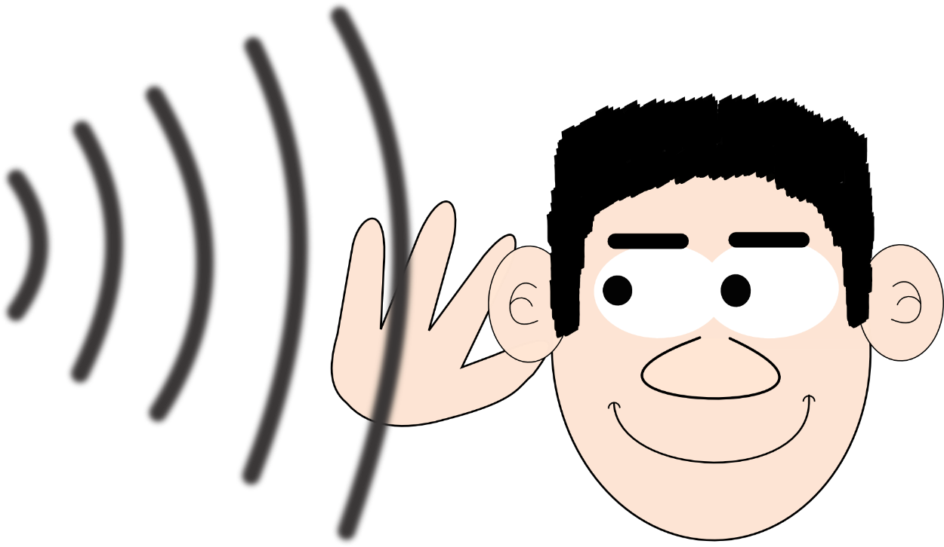
Reading Game:
I’m thinking of a bird starting with…

Slide 25
The Owl and the Woodpecker—Storytelling Tips
The second book segues away from the notion of t-t-t-tennis to a book about a t-t-t-tapping woodpecker. When I delivered this storytime, every time the woodpecker t-t-tapped on the tree, and irritated the sleepy owl, the kids all joined in with the t-t-t action and sound.
This book explores a dramatic, exploitable emotional range through the characters’ conflict, so it’s a great story to indulge with a bit of melodrama.
I chatted with the kids as we went about the plot, the characters, their feelings, what you think they’re going to do, and/or where the story might be going.
I also paperclipped some of this second book’s pages together, to remove an extraneous subplot that I felt would lose their attention.

Slide 26
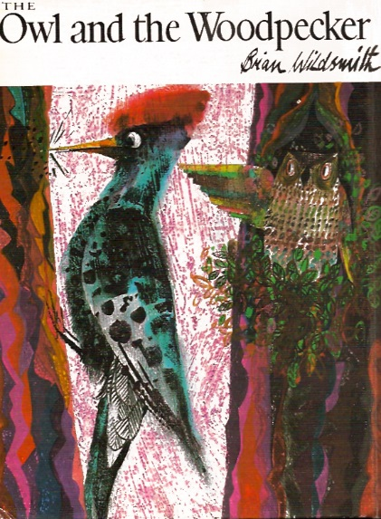
The Owl and the Woodpecker
Conversational Reading
Think of the 3Ss as steps upwards in literacy:
SEE: “Banana. You’re looking at the yellow banana.”
SHOW: “Can you point to the dog? Tickle the monkey’s toes? Cover the man’s hat? How does the kangaroo move? Show me how you clap your hands.”
SAY: How? Who? When? Where? Why? What? Parent: “What is the cow doing?” Child: “Eating grass!”
https://3a.education.unimelb.edu.au/assets/3a-public/downloads/3A-Conversational-Reading-Booklet.pdf

Slide 27
Wedge-Tailed Eagle
Tune: Frere Jacques
[A] Wedge-tailed eagle (flap wings)
Wedge-tailed eagle
Cockatoo (place hand/spread fingers on head like crest)
Cockatoo
Kookaburra, emu (kookaburra = right hand make beak)
Kookaburra, emu (emu = left make beak way above head)
[A] Kang- [E] a- [A] roo (hop like kangaroo)
[A] Kang- [E] a- [A] roo
A bird song to segue from The Owl and the Woodpecker. Talking about (and make) the sounds of these birds. Cockies, emus and kookaburras all make fantastic noises for child engagement.

Slide 28
Wedge-Tailed Eagle
(Tune: Frere Jacques)
Wedge-tailed eagle, wedge-tailed eagle
Cockatoo, cockatoo
Kookaburra, emu
Kookaburra, emu
Kangaroo, kangaroo
Notes:
Movement Song
Standing
Wedge Tail eagle: arms out and flap like wings
Cockatoo: one hand on head, fingers spread out like a crest
Kookaburra: hand making bird beak movement at the level of shoulder
Emu: sweep hand making bird beak from shoulder upwards to make an emu shape
Kangaroo: hands in front like paws and jumping

Slide 29
Two Little Dickybirds
Two little dickybirds Hold up 2 forefingers
Sitting on a wall
One named Peter Bring one finger forward
One named Paul Bring other finger forward
Fly away Paul ‘Fly’ hands behind back, one by one
Fly away Peter
Come back Paul ‘Fly’ each hand back, one by one
Come back Peter

Slide 30
Two Little Dickybirds
Two little dickybirds
Sitting on a wall
One named Peter
One named Paul
Fly away Paul
Fly away Peter
Come back Paul
Come back Peter

Slide 31
Time—Storytelling Tips
This book might seem, at first sight, like a bad choice for a group read aloud book, but which, in fact, is a perfect example of how a simple book can be creatively brought alive: Time by Jan Pieñkowski. (Because, of course, clocks go t-t-t-t, too. Tick, tock, tick, tock.)
In Time, there is a clock face with a different time on each page, along with an illustration of what people are likely to be doing at that time, like getting out of bed. Each page, the kids and I stood with our hands together, straight above our heads, at twelve o’clock. Then we physically counted with our minute-hands (their right hands, my left for mirrored modelling), ticking around like giant windmill-clocks, to arrive at the time of day currently featured in the book, eg 6am.
Then we, in some way, embodied the pictures. So, for example, we yawned and stretched for getting out of bed. (A lovely bonus is to watch the empathy contagiously spread around the room as everyone starts subconsciously yawning together!) We sang, on that page of the book, ‘I Jump Out Of Bed in the Morning’. (Don’t be afraid to interject songs—planned or unplanned—into book readings!)

Slide 32
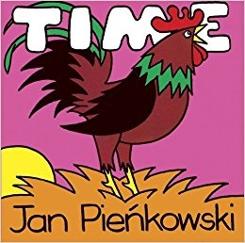
Time
Conversational Reading
Think of the 3Ss as steps upwards in literacy:
SEE: “Banana. You’re looking at the yellow banana.”
SHOW: “Can you point to the dog? Tickle the monkey’s toes? Cover the man’s hat? How does the kangaroo move? Show me how you clap your hands.”
SAY: How? Who? When? Where? Why? What? Parent: “What is the cow doing?” Child: “Eating grass!”
https://3a.education.unimelb.edu.au/assets/3a-public/downloads/3A-Conversational-Reading-Booklet.pdf

Slide 33
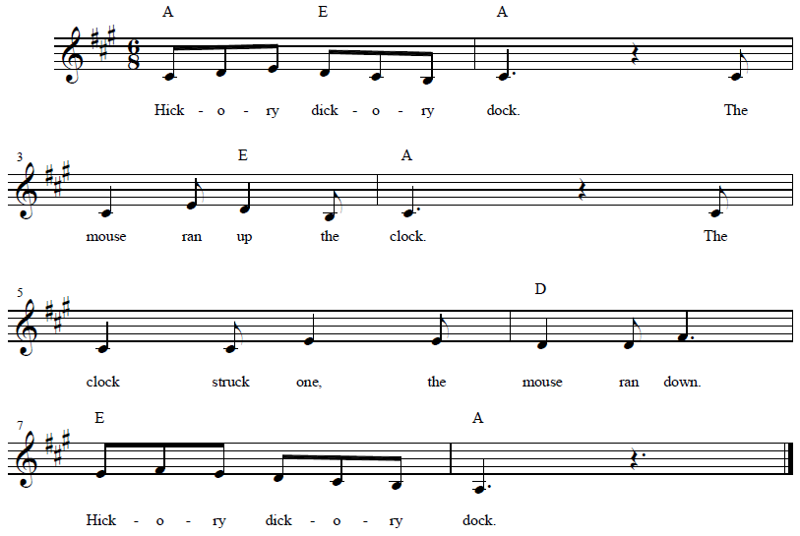
Hickory Dickory Dock With Little Wordless Book http://www.nancymusic.com/SOM/2015/hickory-dickory-dock.htm
Print and download Nancy Stewart’s Little Wordless Book to go with this song. Alternatively, you could print a copy for every child to take home. (It’s a single page printout, that folds cleverly into an eight page book.)
NOTE: Nancy sings a different melody for this song than I’m used to. I have embedded her audio track in the duplicate song slide. (See speaker in top right corner.) If her version is also not the one you’re familiar with, delete the duplicate slide with the embedded mp3, and simply keep the original lyrics slide.
Use rhythm sticks for tick tock.

Slide 34
Hickory Dickory Dock
Hickory dickory dock
The mouse ran up the clock
The clock struck one
The mouse ran down
Hickory dickory dock

Slide 35
Hickory Dickory Dock
Hickory dickory dock
The mouse ran up the clock
The clock struck one
The mouse ran down
Hickory dickory dock

Slide 36
Letter Formation

Slide 37
Jolly Phonics Songs
(Tune: The Muffin Man)
When I watch the tennis game
t, t, t
t, t, t
When I watch the tennis game
My head goes back and forth
Download the actions: http://jollylearning.co.uk/gallery/jolly-phonics-actions/

Slide 38
Craft to Conclude (tennis visor only for older kids)
Provide kids with two activities (craft suggestion on next hidden slide for you to print):
  The Jolly Phonics letter tracing sheet/colour-in from The Phonics Handbook (https://dominie.com.au/products/JL-073).
  A craft activity linked, where possible, to the theme. Keep these varied, and use them as an opportunity to explore, week to week, different fine motor skills (like cutting with scissors along lines). The http://krokotak.com/ and https://www.firstpalette.com websites are great for single page templates.
Carers will need to be reminded/encouraged not to take over the project for the kids. The goal is not a perfect construction, but practice at foundational skills. If the carers take over, the final product might look very nice, but the child hasn’t learned/practiced anything!
Instead, encourage carers to prioritise language, explore concepts, and emphasise relationship-building in their interaction.
Encourage kids to write their names on their work. My memory is strongly visual, and I remember kids names better if I’ve seen them written down week to week.
Create a culture where the kids bring their finished craft to you to show you. It’s a fabulous opportunity for one on one conversational interactions, joint attention, and addresses three foundational ideas of the Abecedarian Approach: that interactions be individual, frequent, intentional. It’s frequent if it’s every week. It’s individual if you focus on each child (and their work) one by one. It’s intentional if you use the opportunity for evidence-based language interactions. Use growth rather than fixed mindset language (ie, don’t label the child good/bad, label the work/effort: I love the colours you’ve chosen; I can see how carefully you’ve coloured to stay inside the lines). Use rich vocabulary to describe what they’ve produced. Play with them. (If it’s a mask, for example, put it over your face and make the animal’s sounds. Then put it in front of the child’s face, and invite them to make the sounds.) Ask them about their choices. Notice, Nudge, Narrate.

Slide 39
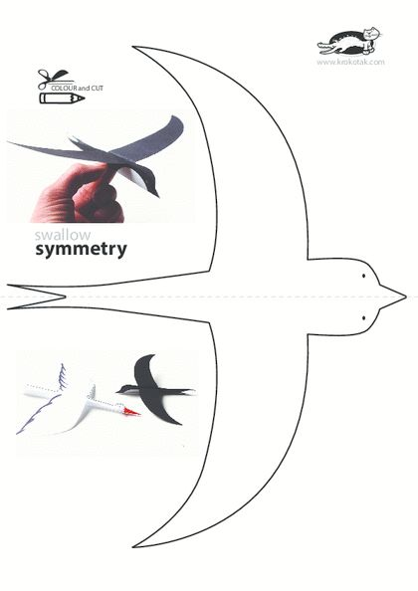

Slide 40
Tennis Visor
“Crease along the dotted lines
Crease along the dotted lines by running the point of a pencil or an inkless pen across both lines. Make the crease as deep as you can (without puncturing the paper) by applying pressure as you run the pencil along the lines. Deeper creases will make folding much easier.”
“Fold up along the upper dotted line
Fold the visor up along the upper dotted line. Further crease the line by running your finger along the fold. Unfold.”
“Fold down along the lower dotted line
Folding down along the lower crease is a bit tricky because the line is curved. Crease down along the curved line a section at a time until the entire crease has been folded downwards. Unfold.”
“Glue the middle section
With the creases created, apply glue on the visor's entire middle section bordered by the two dotted lines. Next, fold up along the upper crease and press on the area to glue it in place.”
“Create the brim
Hold the visor at the middle of the folded edge. Carefully bring the curved edge of the visor towards you. This step creates the visor's brim or front part. Hold both ends of the visor and carefully push them towards the back to allow the visor to assume a more curved shape.”
https://www.firstpalette.com/Craft_themes/Wearables/papervisor/papervisor.html

Slide 41
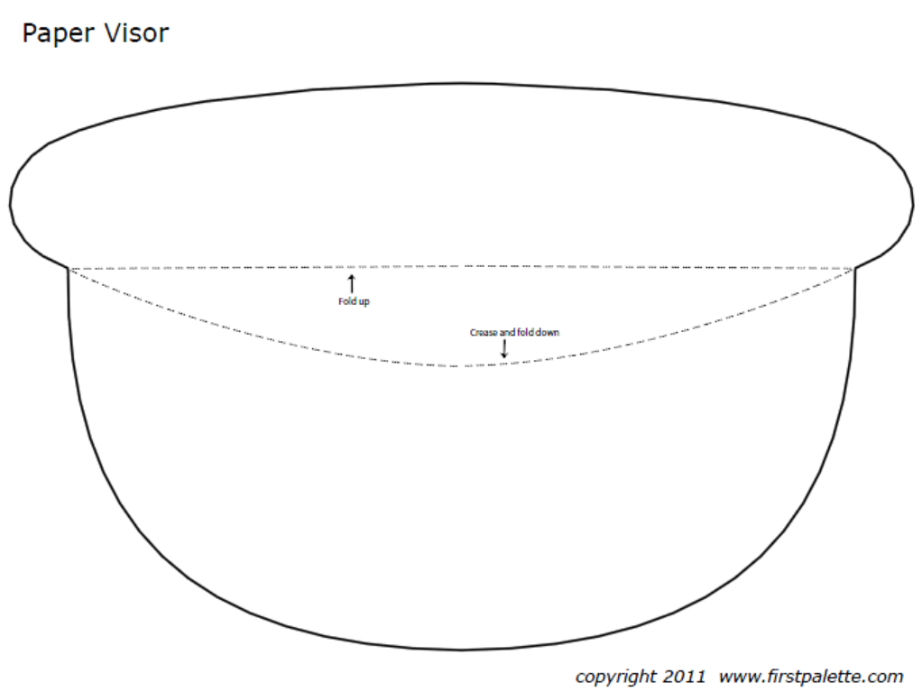

Slide 42
Craft: birds, like the t-t-tapping woodpecker!

Slide 43




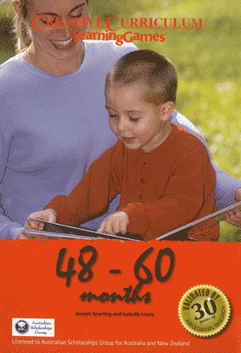
Informal Playgroup After Storytime
Encourage carers and kids to stick around for an informal sort of playgroup. This would be a great opportunity to set up a few different 3a LearningGamesTM stations each week: http://www.earlychildhoodaustralia.org.au/shop/product/learning-games-5-books-set/
The pages in these books are thick, and perforated, to be pulled out as game cue cards. Some libraries have been laminating these, barcoding them, and loaning them to families, with relevant props/equipment, if required/useful.
Some of the best training you’ll do in early learning is the 3a three-day PD.

Slide 44

Storytime Playgroup:
Please stay to play, chat and get to know one another!
Photograph link for later:
3a.education.unimelb.edu.au

