Slide 1
A Year of Storytimes
Week 1
Sound of the Week:
s for snake
Download the actions: http://jollylearning.co.uk/gallery/jolly-phonics-actions/

Slide 2
Sample Library Preschool Storytime: SSSSS for Snake!
This is a sample storytime for librarian learning and planning purposes. It is not a script; it is a case study. It is not meant to be prescriptive, nor to be memorised word-for-word. By all means, replicate some or all of the session plan’s bones (books, songs, games, props), but put your own spin on it!
This session incorporates evidence-based literacy techniques, and is designed to empower both children, and parents in particular, with practically-modelled strategies to use at home, both now, and also well into the school years, when the children start bringing readers home.
It has been developed with the best of whole-language and phonics approaches in mind, and balances explicit phonemic awareness and reading games with high-quality, rich dialogic and immersive literature engagement.
See elsewhere on the website for the foundational research base behind this session, and for a video modelling and explaining the choices in action: www.earlylearningcontinuum.com.au.

Slide 3
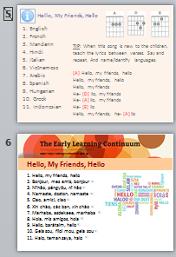
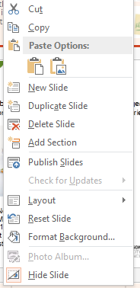
Parent Handout
Slides 4 & 5 are hidden and will not play in the presentation. (Same goes for these info slides.)
Print slides 4 & 5 back-to-back for a one-sheet (double-sided) parent handout.
Encourage the families to stick the speech sound bubble on the wall at home, or stick it in a special scrapbook for when their children are learning to read.
Some other snake-related songs by Nancy Stewart that you may want to add, depending on the age of your cohort:
  http://www.nancymusic.com/SOM/2017/snakes-like-to-snuggle.htm
  http://www.nancymusic.com/SOM/2013/hibernating-animals.htm
↑ Hidden slides look pale, and have a strike through their number.
Right click to select either public or hidden page layouts for new slides.

Slide 4

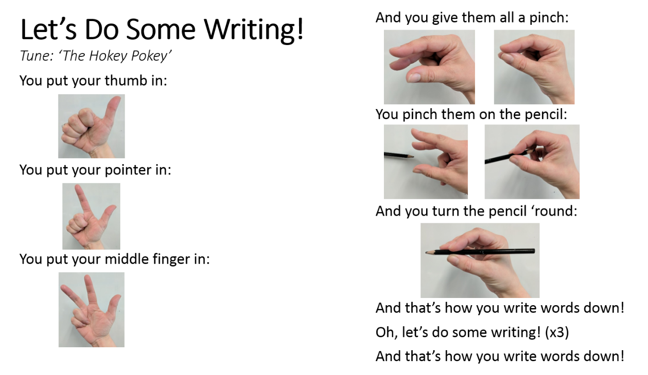
Storytime Sound of the Week: Useful Resource Links:
Download the free Jolly Phonics Parent and Teacher Guide: http://jollylearning.co.uk/parent-teacher-guide/
Download the free Jolly Phonics Actions Sheet: http://jollylearning.co.uk/gallery/jolly-phonics-actions/
Buy the Jolly Songs book and CD at https://dominie.com.au/products/JL-695
Purchase and download the Jolly Songs album on:
- iTunes: https://itunes.apple.com/us/album/jolly-songs-in-british-english/935294825
- Google Play (as an app): https://play.google.com/store/apps/details?id=com.jollylearning.jollysongs
Listen to the Jolly Songs on YouTube: https://youtu.be/ByPW0xDpsnE
Download various Jolly Learning interactive literacy apps on your:
- iPhone or iPad: https://itunes.apple.com/us/developer/jolly-learning/id897894555?mt=8
- Android phone or tablet: https://play.google.com/store/apps/dev?id=8325657000152317866
Over 200 free children’s songs, downloadable as mp3s: www.nancymusic.com and www.singwithourkids.com
Free downloadable online readers from SPELD SA: http://www.speld-sa.org.au/services/phonic-books.html
Visit www.earlylearningcontinuum.com.au for free Reading Games (interactive readers), songs, books, videos, and information for parents.
YouTube channels for carers to learn more:
- Miss Emma, The Reading Whisperer: https://www.youtube.com/channel/UCbsjRiM-Z-Bjk20wzF-MOUw
- Sarah Librarian’s Jolly Phonics playlist: https://www.youtube.com/playlist?list=PL7CWH34MqRng86RWj7Fpsp0Y1ZH9RKmJP
https://www.speechsoundpics.com/speech-sound-detectives
Be speech sound picture (SSP) detectives!

Slide 5
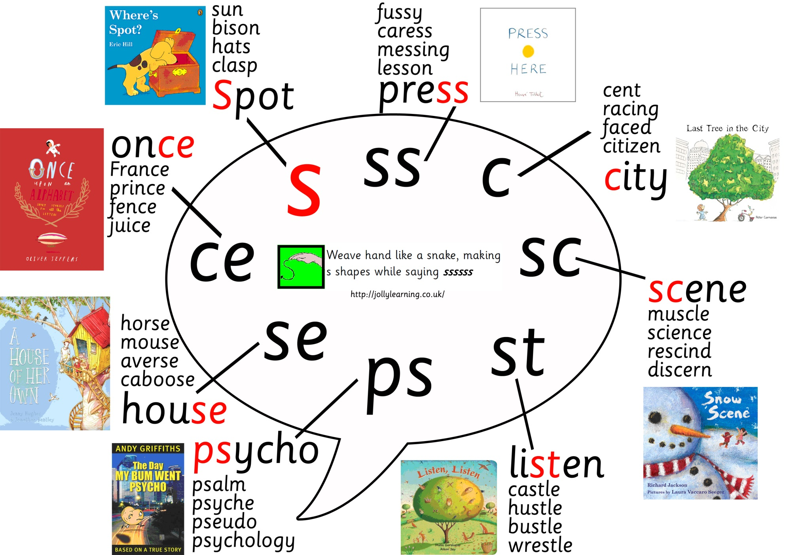
Speech bubble for s

Slide 6
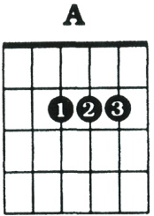
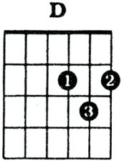
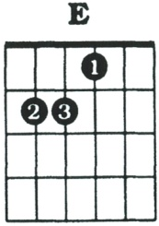
Hello, My Friends, Hello
English
French
Mandarin
Hindi
Italian
Vietnamese
Arabic
Spanish
Hungarian
Greek
Indonesian
Alternative Hello Songs
TIP: When this song is new to the children, teach the lyrics between verses. Say and repeat. And name/identify languages.
[A] Hello, my friends, hello
Hello, my friends, hello
Hello, my friends
He- [D] llo, my friends
He- [A] llo, my friends
He- [E] llo
Hello, my friends, he- [A] llo

Slide 7
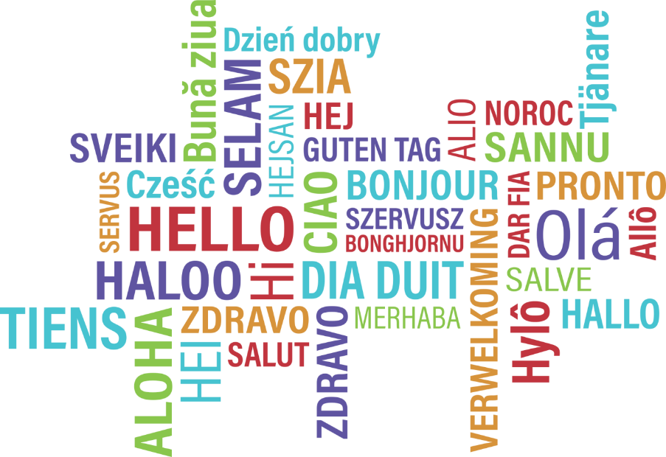

Hello, My Friends, Hello
1. Hello, my friends, hello
2. Bonjour, mes amis, bonjour
3. Nǐ hǎo, péngyǒu, nǐ hǎo
4. Namaste, doston, namaste
5. Ciao, amici, ciao
6. Xin chào, các bạn, xin chào
7. Marhabaan, asdekaee, marhabaan
8. Hola, mis amigos, hola
9. Hello, barátaim, hello
10. Geia sou, fíloi mou, geia sou
11. Halo, teman saya, halo

Slide 8
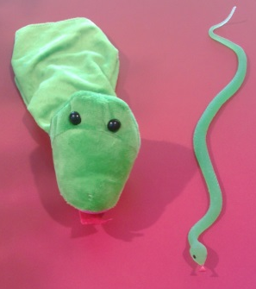
Introduce Jolly Song Scenario
For example:
Point to the picture: “what’s this?” The kids will shout out SNAKE! “What sound does it make?” SSSS! “That’s our sound of the week!” Use props to bring alive, where possible.
“Can you pretend your arms are a ssslippery, ssslidey, ssslithering sssnake? [Do action with them.] Ssssssssssss! Imagine your sssnake sssneaking through the grasssssss.”
Segue to song.
Repeat song for learning and memory retention.
Buy the Jolly Songs on Google Play or iTunes, and then embed the mp3 in this presentation by going to Insert >> Audio >> From File/On My PC. Embed the audio into a duplicated lyrics slide, and set playback to “automatically” (instead of “on click”). When you click “next”, nothing will change on the screen, but the audio will start playing. (See Ridin' Along and Singin' a Song slides, below, for demonstration.)

Slide 9
Jolly Phonics Songs
(Tune: The Farmer in the Dell)
The snake is in the grass
The snake is in the grass
Sssssss sssssss
The snake is in the grass
Download the actions: http://jollylearning.co.uk/gallery/jolly-phonics-actions/

Slide 10
Sound of the Day: S
Slide is animated: Text and camera will appear first. Clicking “next” will make the first S appear, and clicking “next” again will reveal the other S/book cover.
With just the camera on screen: “If we were to take a picture of the sssnakey ssss sound, what would it look like?”
Get out camera prop—they LOVE this. Let them hear the clicking sound. Get them to pretend to hold up an imaginary camera and say, “click!”
Press NEXT, after playing with cameras, to reveal picture of the ssss sound.
“What do you think this wiggly shape looks like?” NEXT for pink S with snake.
“When you want to write down the ssss sound, that’s how you can draw a picture of it.”

Slide 11
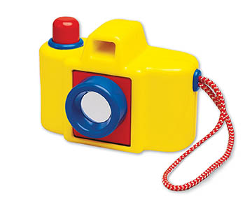
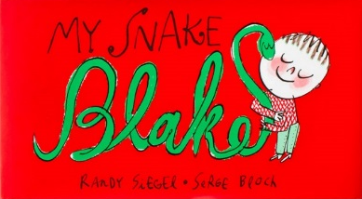

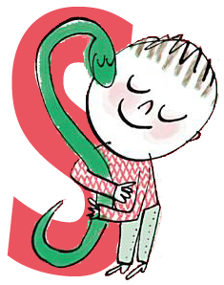
Sound of the Day:
What would a picture of today’s sound look like?

Slide 12
Pencil Grip Song: Let’s Do Some Writing!
“Let’s make sure we’re holding our pencils just right so we can draw a beautiful picture of the ssss sound in the air.”
With smaller groups, you could hand out a pencil or crayon for the kids to hold. It’s not necessary, though; they can imagine. The important thing is that they’re practicing pencil grasp—the pinch or tripod grip.
Use a pencil yourself, however, so you’re demonstrating fully how the carers and kids can use the song at home to get their grip just right.
MAKE SURE YOU DRAW THE LETTER BACKWARDS IN THE AIR!!! They will mirror whatever you do. You might remember your ballet teacher doing this when you were little: when you face them, use your left for their right/your right for their left.

Slide 13
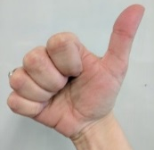
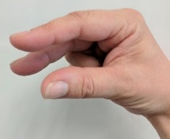
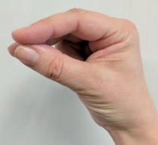
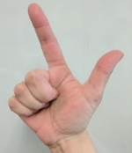
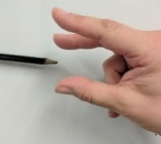
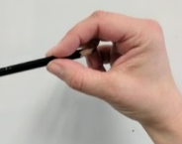
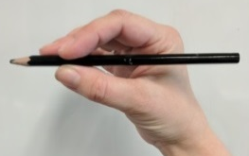
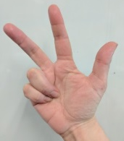
Let’s Do Some Writing! (Tune: The Hokey Pokey)
You put your thumb in:
You put your pointer in:
You put your middle finger in:
And you give them all a pinch:
You pinch them on the pencil:
And you turn the pencil ‘round:
And that’s how you write words down!
Oh, let’s do some writing! (x3)
And that’s how you write words down!

Slide 14
Letter Formation for Sound of the Day
“Let’s practice writing the ssss sound with our pinchy pencil fingers.”
“Start at Blake the Snake’s head, and follow his windy body down one way and then the other.”
Practice multiple times. Make a big fuss about how beautiful their sss pictures look in the air, and what wonderful writers they’re becoming.

Slide 15

Letter Formation

Slide 16
Info for Parents: Setting Up Future Spelling Choices*
“There are actually some other ways to picture the ssss sound. When you’re older and at school, and you’re super-duper readers, you will be able to read and write AAAALLLLLLL THEEEESE [point around the bubble] pictures of the sssss sound. Isn’t that amazing? But today, we’re just looking at the main picture of sssss, the sssnakey sssss in red just there…”
*Spelling choice = the THRASS term for a speech sound picture. For example, “s” in snake is a one letter spelling choice; “st” in castle is a two letter spelling choice; “ough” in through is a four letter spelling choice. http://files.sthildas.qld.edu.au/wp-content/uploads/2014/10/THRASS-Bookmark.pdf

Slide 17

Speech Bubble for s
Be speech sound picture (SSP) detectives!
For more about SSP detective work:
www.speechsoundpics.com

Slide 18
The Snake and the Boy: Storytelling Tips
“…And now I’ve got a sssssnakey ssssstory for you!”
Flag that it is an Indigenous text, and by a child like them! (Azmen Sebastian was predominantly 8yo during the writing/illustration of this book. More info: https://www.thefreelibrary.com/The+Snake+and+the+Boy%3A+Azmen+Sebastian+interview.-a0258438833)
Use a green blanket/sheet/piece of cloth, and in front of the kids, roll/bunch it up and transform it into a long green snake, explaining/narrating what you’re doing as you go, and engaging with their verbal gambits. [I used a blanket in this instance, rather than a green rope, stocking, or toy, because I linked the transformation of the blanket into a snake with the book I used next in this session: It’s Not Just a Blanket! See slides 25-6.)
Use the enormous tree picture on the next slide (slide 19) in your theatrics. Make your snake climb down the tree, around on the ground, and back up the tree.
Use a real apple. Place it on the ground. Slide the snake to it. Take two large bites yourself, as if you are the snake. And don’t be afraid to “struggle” to talk with your mouth full of apple—they kids will find that hilarious.

Slide 19

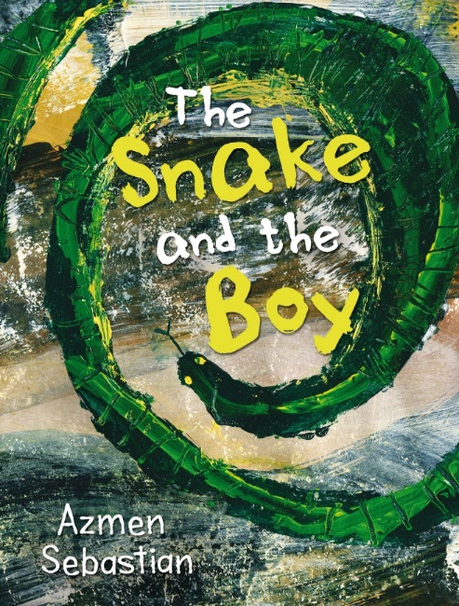

Slide 20
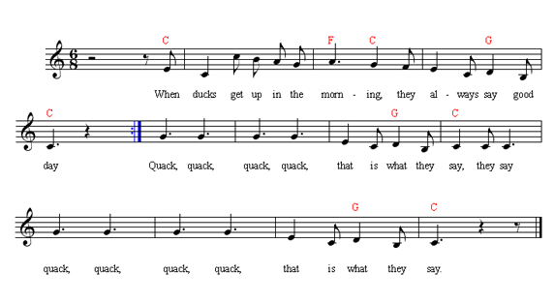
When [Snakes] Get Up in the Morning
http://www.nancymusic.com/Ducksplay.htm
All of the animals I selected for the verses link to other Jolly Phonics sound mnemonics. Duck = qu, mice = i, bees = z, trains = ch.

Slide 21

When Snakes Get Up in the Morning (Nancy Stewart)
When snakes get up in the morning
They always say good day
When snakes get up in the morning
They always say good day
SSS, SSS, SSS, SSS
That is what they say, they say
SSS, SSS, SSS, SSS
That is what they say
Ducks
Mice
Bees
Trains!
Visit www.nancymusic.com
to download this FREE
children’s song at home!

Slide 22
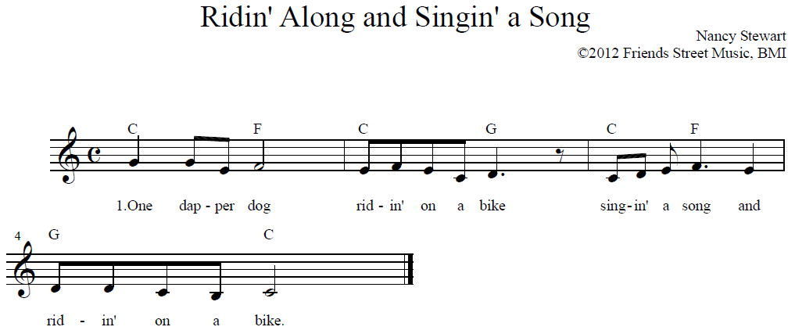
Ridin' Along and Singin' a Song http://www.nancymusic.com/SOM/2012/ridin-along-singing-a-song.htm
Download Nancy’s printable picture book to accompany this counting song: http://www.nancymusic.com/SOM/2012/ridin%20along%20singin%20a%20song%20book.pdf
Audio is embedded in an exact duplicate copy of the lyrics slide. The first slide will indicate what’s coming next, and when you’re ready, click “next”. Nothing will change on screen, but the audio will start playing.

Slide 23
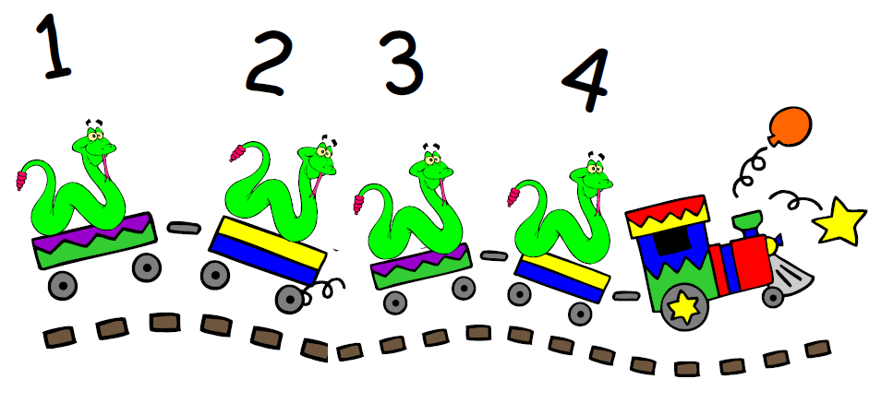
Ridin' Along and Singin' a Song
1 One dapper dog ridin’ on a bike
singin’ a song and ridin’ on a bike
2. Two clever cats ridin’ in a car
singin’ a song and ridin’ in a car
3. Three dainty ducks ridin’ in a boat
singin’ a song and ridin’ in a boat
4. Four sneaky snakes ridin’ on a train
singin’ a song and ridin’ on a train
5. Five brittle bugs ridin’ on a plane
singin’ a song and ridin’ on a plane
6. See the menagerie ridin’ on a bus
singin’ together and ridin’ on a bus

Slide 24
Ridin' Along and Singin' a Song
1 One dapper dog ridin’ on a bike
singin’ a song and ridin’ on a bike
2. Two clever cats ridin’ in a car
singin’ a song and ridin’ in a car
3. Three dainty ducks ridin’ in a boat
singin’ a song and ridin’ in a boat
4. Four sneaky snakes ridin’ on a train
singin’ a song and ridin’ on a train
5. Five brittle bugs ridin’ on a plane
singin’ a song and ridin’ on a plane
6. See the menagerie ridin’ on a bus
singin’ together and ridin’ on a bus

Slide 25
It’s Not Just a Blanket: Storytelling Tips
Use your green blanket/sheet from the previous book to act out all the scenarios in the book as you go.
I stand during my storytimes (unless they are small, intimate groups—which is rare!). For this book, I try to remember to pre-set a chair, so that I can properly hang upside down like a bat. If not, I turn my back to them and bend over, looking at the crowd through my legs. Either way, it’s silly, and therefore a big hit with the kids.
Get the kids up the front to engage in a tug-of-war over the blanket at the appropriate point in the story.

Slide 26
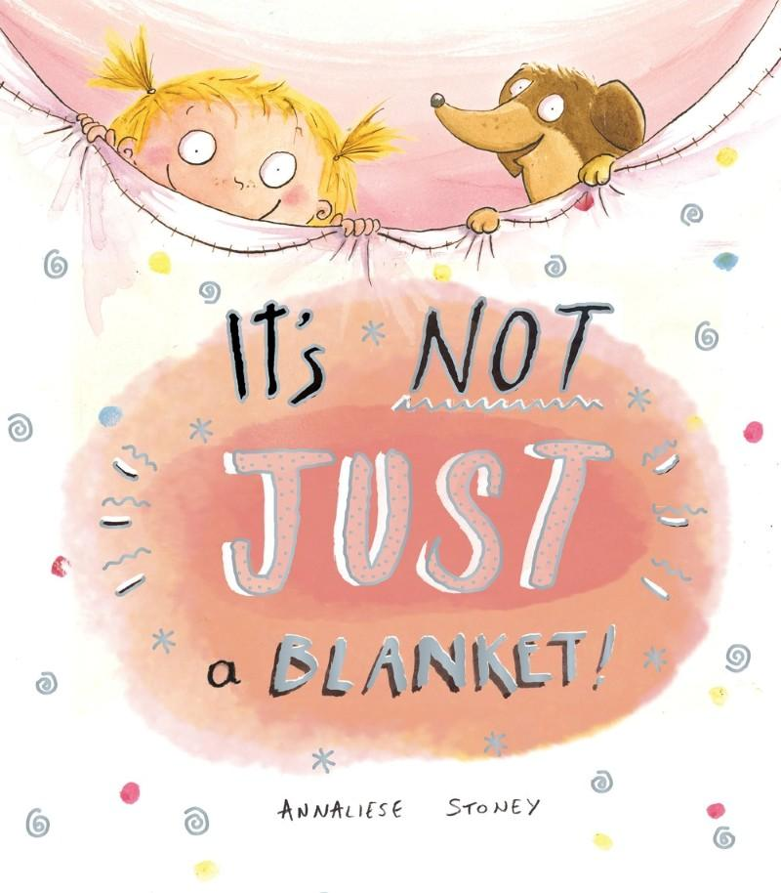

It’s Not Just a Blanket!
Conversational Reading
Think of the 3Ss as steps upwards in literacy:
SEE: “Banana. You’re looking at the yellow banana.”
SHOW: “Can you point to the dog? Tickle the monkey’s toes? Cover the man’s hat? How does the kangaroo move? Show me how you clap your hands.”
SAY: How? Who? When? Where? Why? What? Parent: “What is the cow doing?” Child: “Eating grass!”
Download at 3a.education.unimelb.edu.au

Slide 27
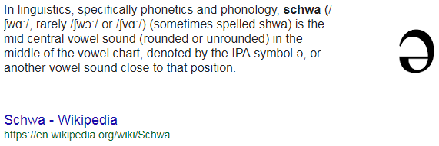
Phonemic Awareness Game: How many sounds in…?
Parent learning for week 1: many of the carers aren’t consciously aware, themselves, that words segment into smaller, countable sounds!
Ask the children if they can remember what things the blanket was transformed into in the book. Take the opportunity for recall and dialogic exchange. Use blanket prop to re-enact as you recall together.
Get the children to count along on their fingers as you segment the sounds in the word. Finger-count with them as you speak the sounds, then ask them what number of fingers they are holding up. The images on the slide are animated to appear one by one.
w/er/m = 3
s/t/i/ng/r/ai = 6
sh/i/p = 3
c/ar/p/ə/t = 5
l/ie/ə/n = 4
For info on initial speech sound pics used for each sound, see: http://jollylearning.co.uk/gallery/what-is-jolly-phonics/
In other words, the “lazy” or “dirty” or “grunting” vowel sound we make on unstressed syllables, like the o in dragon.

Slide 28
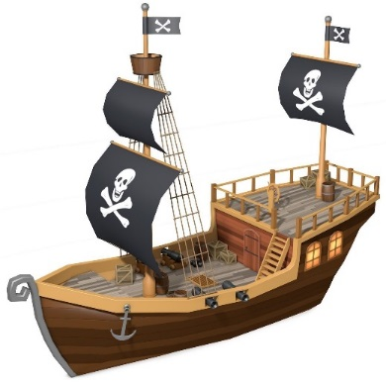
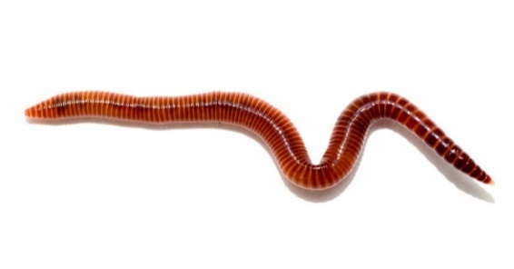
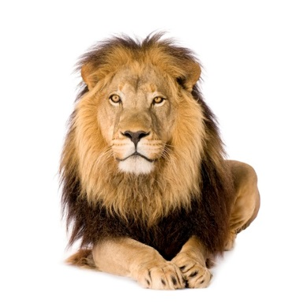
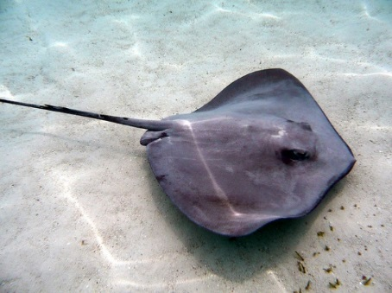
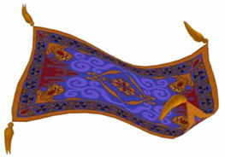
Reading Game:
How many sounds in…?

Slide 29
Zoom Zoom Zoom
Tune: https://youtu.be/8oe6UzVs7_Y
Continue on the theme of It’s Not Just a Blanket: wrap your green cloth around you to be a rocket.

Slide 30
Zoom Zoom Zoom
Zoom zoom zoom
We’re going to the moon
Zoom zoom zoom
We’re going very soon
5, 4, 3, 2, 1
BLAST OFF!!!!

Slide 31

Nursery Rhyme Cube
Print the next hidden slide (slide 31, containing the nursery rhyme cube template), preferably in colour, and preferably in A3 (set to “scale to fit paper”).
Laminate template.
Cut out template.
Use a ruler to help you fold very crisply along each line. (It’s hard to assemble if the folds aren’t crisp and tight.)
Use glue and tape to assemble the finished cube.
Invite a child to throw it high in the air to decide which rhyme you will sing.
Pictured rhymes: I’m a Little Teapot, Incy Wincy Spider, If You’re Happy and You Know It, Der Glumph, The Wheels on the Bus, Twinkle Twinkle Little Star.
Feel free to swap out rhymes you don’t like/don’t know with ones that you do! You can use https://pixabay.com/ for images.
32

Slide 32
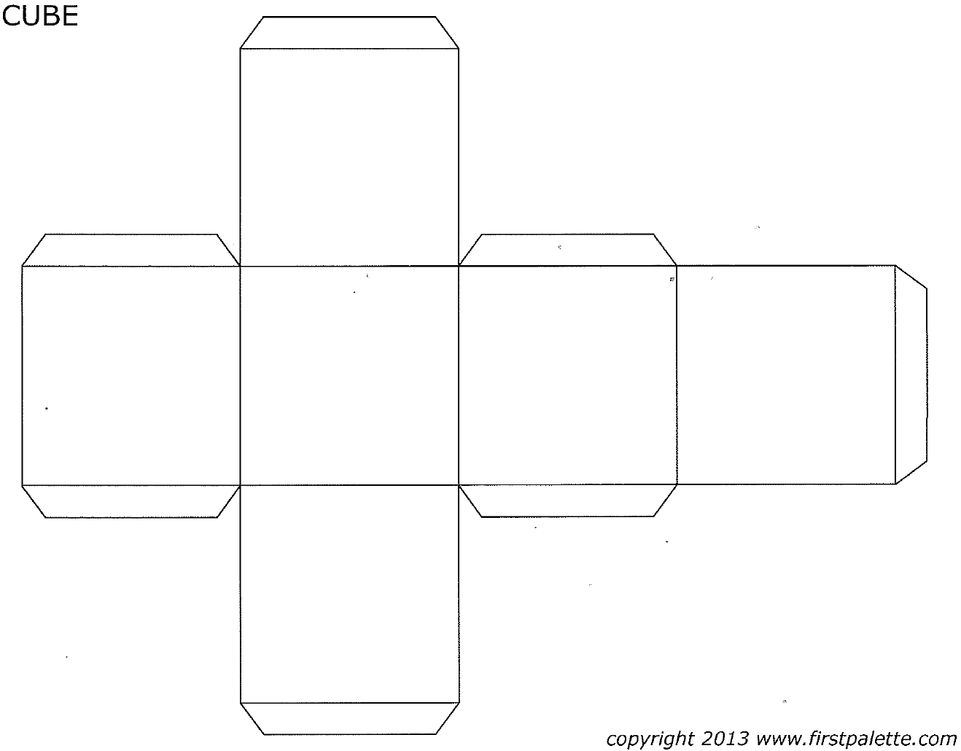
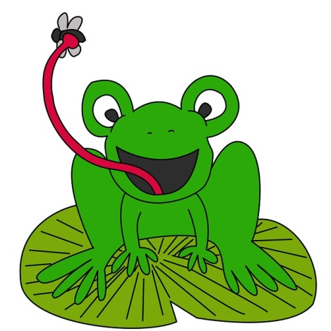

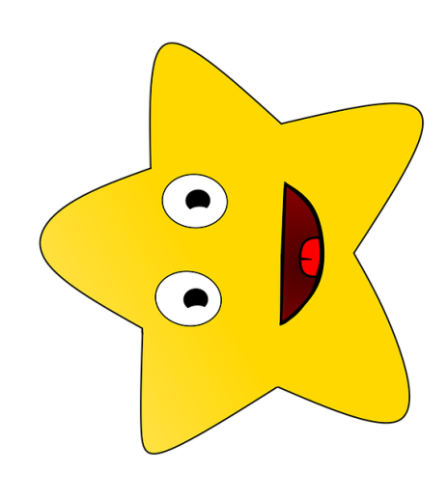



https://www.firstpalette.com/

Slide 33
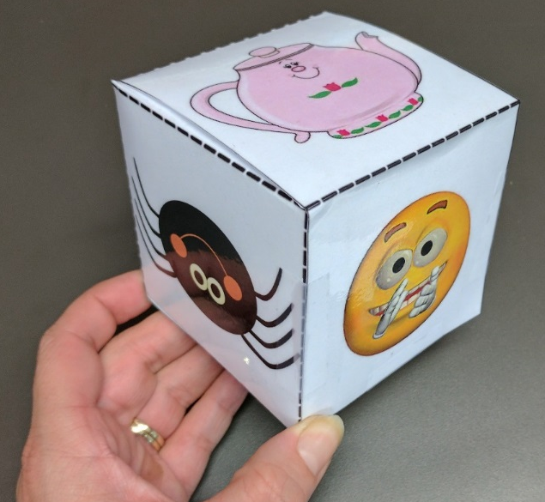
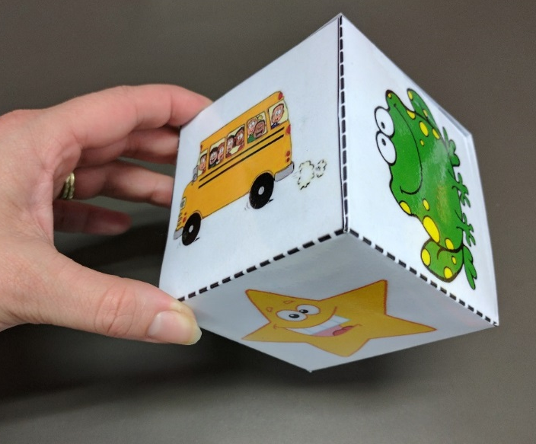
Mystery Rhymes!

Slide 34
Who Am I?: Storytelling Tips
Act out the yoga poses!
Use opportunity to discuss animals, or pictures, ask kids questions, make animal sounds, etc, to extend time spent in pose (if desired).
Sing songs linked to animals while in poses, if desired.
If your session is running too long, you can skip pages/poses, but remember to include the cobra for the snake theme!

Slide 35

Who Am I? Yoga for Children…
Conversational Reading
Think of the 3Ss as steps upwards in literacy:
SEE: “Banana. You’re looking at the yellow banana.”
SHOW: “Can you point to the dog? Tickle the monkey’s toes? Cover the man’s hat? How does the kangaroo move? Show me how you clap your hands.”
SAY: How? Who? When? Where? Why? What? Parent: “What is the cow doing?” Child: “Eating grass!”
Download at 3a.education.unimelb.edu.au

Slide 36
Revise: Letter Formation

Slide 37
Revise: Jolly Phonics Songs
(Tune: The Farmer in the Dell)
The snake is in the grass
The snake is in the grass
Sssssss sssssss
The snake is in the grass
Download the actions: http://jollylearning.co.uk/gallery/jolly-phonics-actions/

Slide 38
Craft to Conclude
Provide kids with two activities (craft suggestion on next hidden slide for you to print):
  The Jolly Phonics letter tracing sheet/colour-in from The Phonics Handbook (https://dominie.com.au/products/JL-073).
  A craft activity linked, where possible, to the theme. Keep these varied, and use them as an opportunity to explore, week to week, different fine motor skills (like cutting with scissors along lines). The http://krokotak.com/ website is great for single page templates.
Carers will need to be reminded/encouraged not to take over the project for the kids. The goal is not a perfect construction, but practice at foundational skills. If the carers take over, the final product might look very nice, but the child hasn’t learned/practiced anything!
Instead, encourage carers to prioritise language, explore concepts, and emphasise relationship-building in their interaction.
Encourage kids to write their names on their work. My memory is strongly visual, and I remember kids names better if I’ve seen them written down week to week.
Create a culture where the kids bring their finished craft to you to show you. It’s a fabulous opportunity for one on one conversational interactions, joint attention, and addresses three foundational ideas of the Abecedarian Approach: that interactions be individual, frequent, intentional. It’s frequent if it’s every week. It’s individual if you focus on each child (and their work) one by one. It’s intentional if you use the opportunity for evidence-based language interactions. Use growth rather than fixed mindset language (ie, don’t label the child good/bad, label the work/effort: I love the colours you’ve chosen; I can see how carefully you’ve coloured to stay inside the lines). Use rich vocabulary to describe what they’ve produced. Play with them. (If it’s a mask, for example, put it over your face and make the animal’s sounds. Then put it in front of the child’s face, and invite them to make the sounds.) Ask them about their choices. Notice, Nudge, Narrate.

Slide 39
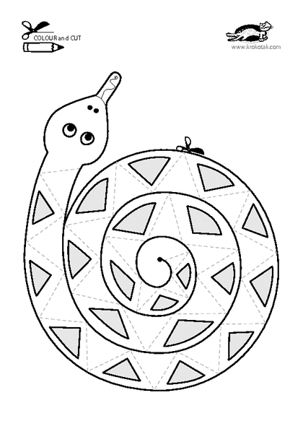
http://print.krokotak.com/q?q=snake

Slide 40
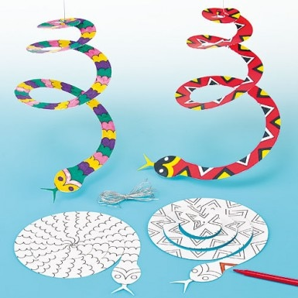
Craft: Spiral Snakes

Slide 41



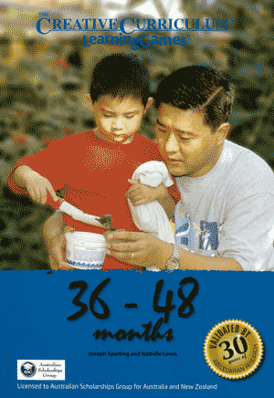
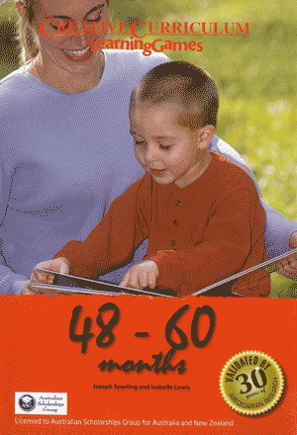
Informal Playgroup After Storytime
Encourage carers and kids to stick around for an informal sort of playgroup. This would be a great opportunity to set up a few different 3a LearningGamesTM stations each week: http://www.earlychildhoodaustralia.org.au/shop/product/learning-games-5-books-set/
The pages in these books are perforated, to be pulled out as game cue cards. Some libraries have been laminating these, barcoding them, and loaning them to families, with relevant props/equipment, if required/useful.
Some of the best training you’ll do in early learning is the 3a three-day PD.

Slide 42

Storytime Playgroup:
Please stay to play, chat and get to know one another!
Photograph link for later:
3a.education.unimelb.edu.au

