Slide 1
Baby Bounce Session Structure
Repeat each session (ie do each twice) for consolidation—for both you, and them!
Session Introduction: Hello/Welcome Song
3a Enriched Caregiving: Songs and Games for Routine Daily Interactions
3a LearningGames™ and Play: Songs and Interactions with Objects and Concepts
Dance/Movement/Whole-Bodied Engagement: Carers on Feet, Holding Baby
A Bedtime Ritual for Every Day:
  3a Conversational Reading: Choral Read with Dialogue Prompts/Modelling
  Lullaby: Nurturing Wellbeing Through Nightly Bedtime Music
Session Close: Goodbye Song
3a Language Priority: Informal Playgroup with Activities for Free Play

Slide 2
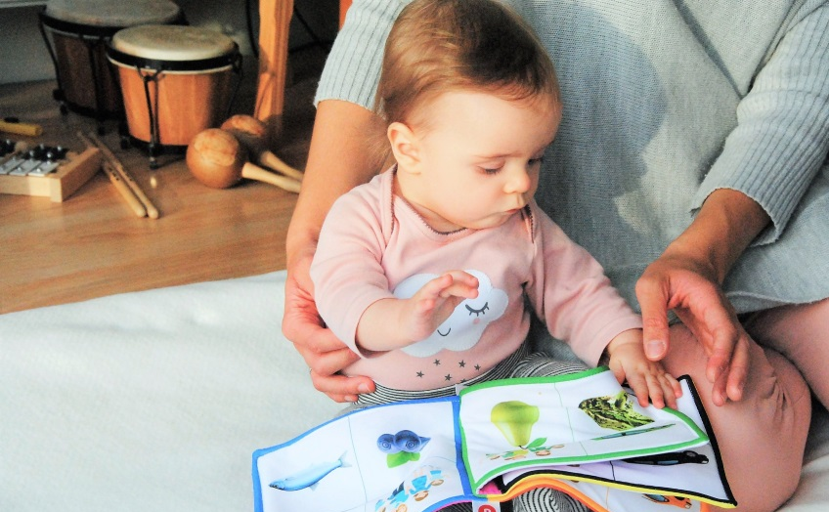

Welcome to Baby Bounce!
What’s the best program for my child’s stage of development?
Is your baby walking?
No, not yet? ➔ Baby Bounce (birth to walking)
Yes, they’re walking? ➔ Toddertime (toddlers)
2. Is your child starting to talk in sentences?
No, mostly just individual/pairs of words
➔ Toddlertime (toddlers)
Yes, they can use/follow longer strings of words
➔ Storytime (preschoolers)
pathways.org/topics-of-development/milestones/

Slide 3
Welcome Song (choose your own)
Same welcome song every week to tie into children’s need for routine and to signal the start of session.
Same welcome song every week to give adults an opportunity to experience the motivating force of mastery at a task.
Name tags important for working names into song (for both adults and kids), which aids relationship building between facilitator and group, and amongst participants.
A gentle, seated activity.
Set up space in a way that encourages families to sit in a circle, so everyone can see your manipulations of/modelling with dolly.

Slide 4

Hello, Everybody
From: Music Together Family Favourites CD
Hello, everybody, so glad to see you x4
Hello to: the babies
the grown-ups
the library
Sarah
www.musictogether.com/store/cds-and-downloads

Slide 5
Enriched Caregiving module (3a)
Songs and rhymes with a particular focus on incorporating them into daily, routine life outside Baby Bounce sessions. Examples of routine situations from the 3a Family Guide for Enriched Caregiving: Getting up in the morning
  Getting dressed or undressed
  Diapering and toileting (change table)
  Washing hands and face
  Eating and mealtime (high chair)
  Going to the supermarket
  Travel/transport
  Taking a nap
  Doing the laundry
  Cleaning up the house
  Taking a bath
  Going to bed at night
We’ll Be Going to The Library…
Make parents leave space and “arrive” again while singing. Repeat if needed.
Start singing second verse when bulk of group is approaching board books.
Start singing third verse with enough time to sing into circle.
Explain that they could sing this when they arrive every week for rich language engagement, and learning about sequences.

Slide 6
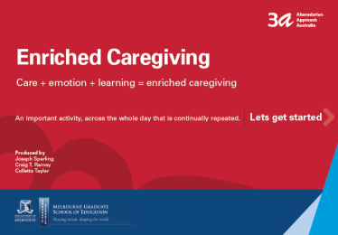
Enriched Caregiving: Routine Outings
Talk about the sequence of routines.
“First, we… Then we… Next we…”
We’ll Be Going to the Library…
(Tune: She’ll Be Coming Round the Mountain)
We’ll be going to the library when we come…
We’ll be picking up a board book when we come…
We’ll be sitting in a circle when we come…
Download at:
3a.education.unimelb.edu.au

Slide 7
Waiting (Train, Doctors, Airport)
Routine tasks like waiting in line take on a whole new level of complexity with a baby. Perfect opportunity for care, connection and content while keeping them from melting down!
Engage carers imaginations in much the same way that you would with older, fluent-speaking children. There are pictures below of waiting locations to awaken the idea for carers; to engage their brains in creative play/theatre.
This is the closest we can get to carers practicing actual waiting in actual places. We recreate it.
Read about “I’m going to get you!” (p.11) and other baby games in Baby Games: The Joyful Guide to Child’s Play from Birth to Three Years by Elaine Martin.

Slide 8
Enriched Caregiving: Routine Outings
WAITING… at the doctors… on a flight… at the train station… for a food order… for Baby Bounce to start… at immunisations…
I’m coming to get you…
I’m coming to get you…
I’m coming to get your… NOSE!
(Do lots of different body parts. Repetition helps babies learn the ritual, the game, and the link between the words and their meaning.)
Download at:
3a.education.unimelb.edu.au

Slide 9
Waiting at the Train Station
Waiting at the train station.
Nowhere to put bubby on the ground. Great time for lapsit games and songs/rhymes.
Imagine how much baby’s crying would echo in that tunnel! We definitely want to avoid that, with engaging, nurturing play and interactions.
LearningGames (birth to 12 months) to link to waiting:
#2 Songs and Rhythm Throughout the Day
#3 Showing Your Baby Something Interesting
#5 Talking to Your Baby
#7 Exploring a Face
#9 Peek-a-Boo
#14 Show Feelings
#16 Ride a Horsie

Slide 10


Slide 11
I Had a Little Pony (Traditional, England)
I had a little pony
That trotted up and down
I bridled it and saddled it
And trotted out of town
Giddy-up, giddy-up, giddy-up horsey
Giddy-up, giddy-up, go, go, GO!
Giddy-up, giddy-up, giddy-up horsey
Giddy-up, giddy-up, WHOA!
Giddy-up

Slide 12
On the Crowded Train
Look at all those people on the train! That’s certainly not a convenient place for bubby to lose patience!
There’s not even anything to look at outside the window.
Perfect routine opportunity for care, connection and content.
Trains themselves can be quite bumpy—good excuse for a bumpy rhyme!

Slide 13


Slide 14
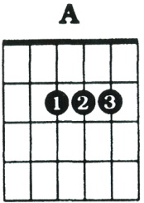
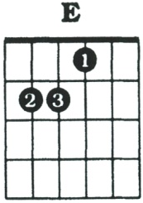
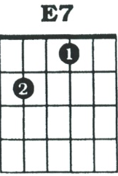
Little Red Wagon
Tune: Ten Little Indians
[A] Bumpin' up and down in my little red wagon
[E] Bumpin' up and down in my little red wagon
[A] Bumpin' up and down in my little red wagon
[E7] Havin' so much [A] fun
Repeat chords for next verse
Introduction = underlined
Repetition: Going really fast down a hill!

Slide 15

Enriched Caregiving
While You Wait: Little Red Wagon
Bumpin' up and down
in my little red wagon x3
Havin' so much fun
Turn the corner
in my little red wagon x3
Havin' so much fun
Download at:
3a.education.unimelb.edu.au

Slide 16
Waiting in the Doctor’s Lounge
The people in the doctor’s waiting room are already feeling unwell, without adding disturbance from grizzling babies. Just the right care occasion to fill with connection and content.
How about a fun bouncing and falling rhyme, that involves someone getting hurt and needing a doctor?

Slide 17
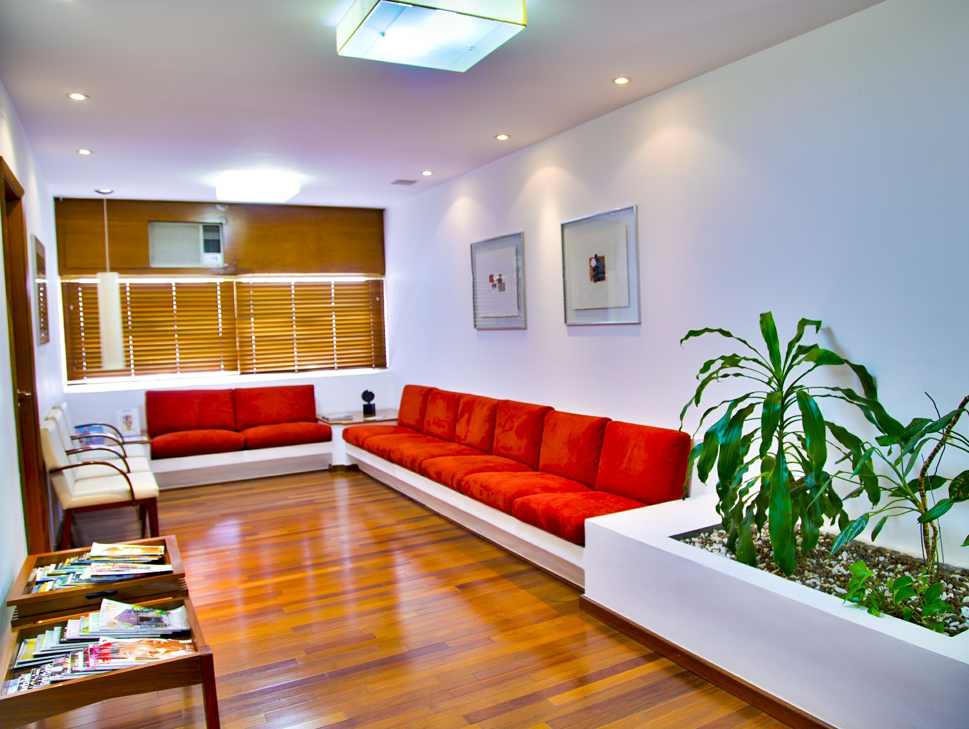

Slide 18
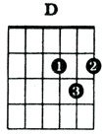
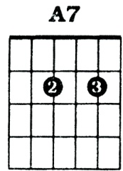
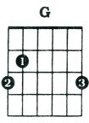
Humpty Dumpty
[D] Humpty [G] Dumpty [A7] sat on the [D] wall
[D] Humpty [G] Dumpty [D] had a great [A7] fall
[D] All the king’s [G] horses and
[A7] all the king’s [D] men
[D] Couldn’t put [G] Humpty to- [A7] gether a- [D] gain
Intro = underlined
PARENT TIP:
Song often used in baby swimming classes. Sit baby on side of pool and bring them into water on “fall”.

Slide 19
Enriched Caregiving
While You Wait: Humpty Dumpty
(Bounce baby on knee, lower baby on ‘fall’)
Humpty Dumpty sat on the wall
Humpty Dumpty had a great FALL!
All the king’s horses and all the king’s men
Couldn’t put Humpty together again
Download at:
3a.education.unimelb.edu.au

Slide 20
Waiting in Queue
Sometimes we might not even be able to sit down while waiting with baby. Doesn’t mean we can’t still fill the waiting time with care, connection and content.
Here’s a standing up song, that can be adapted in a million different ways, for as long as it’s keeping bubby entertained:
  A-kissing we will go
  A-blinking we will go
  A-dipping we will go
  A-spinning we will go
  The list is endless! Get creative!

Slide 21


Slide 22
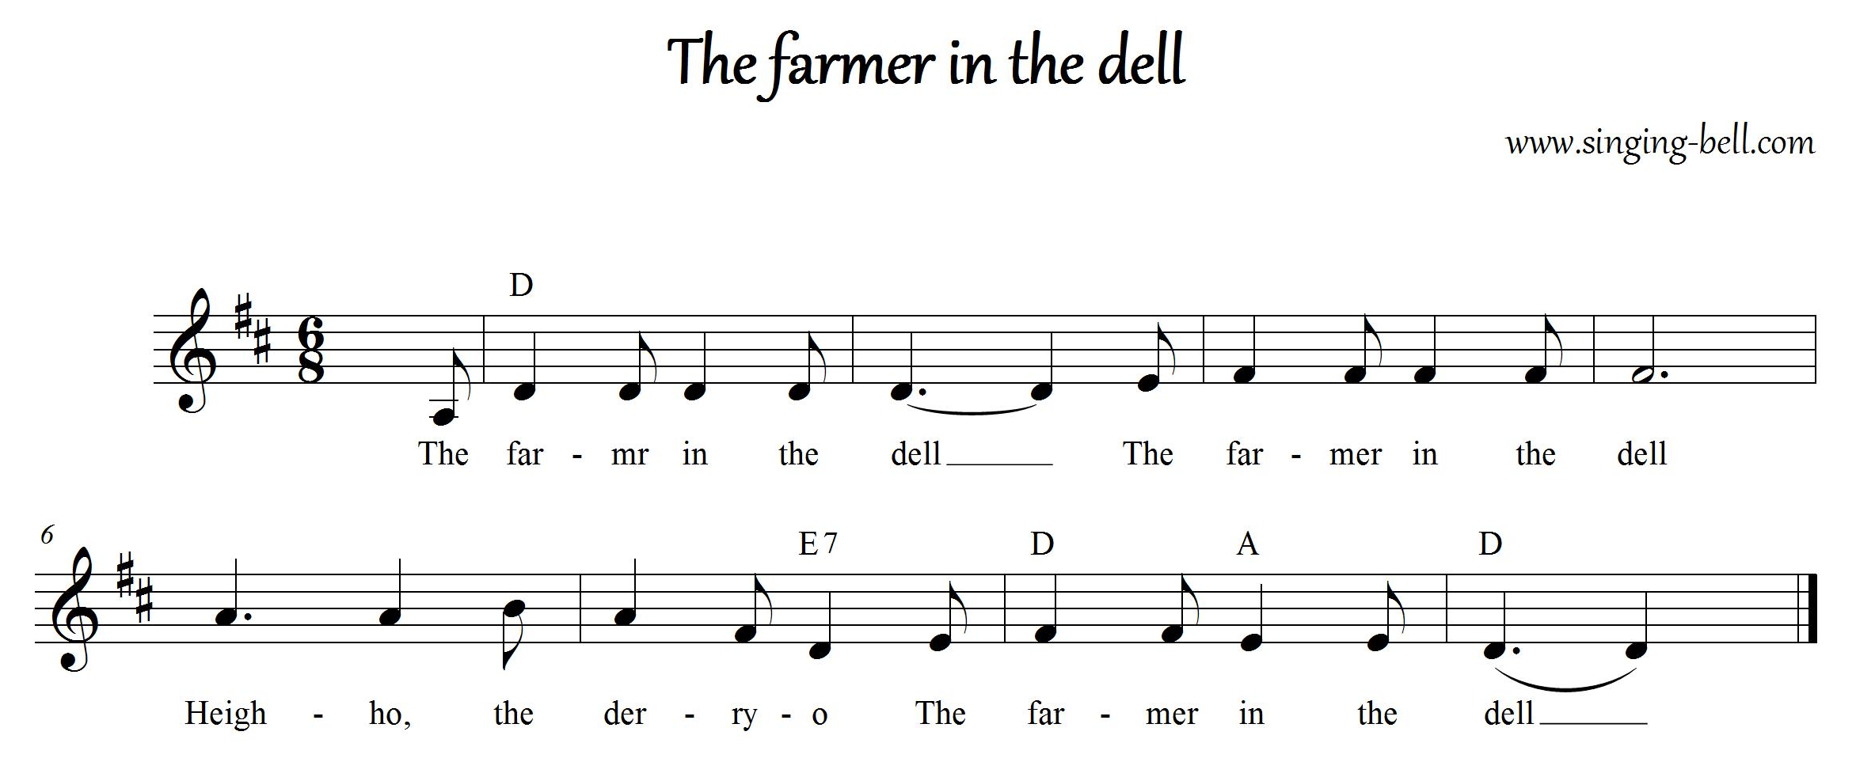
A-Bouncing We Will Go
Tune: The Farmer in the Dell
[D] A-bouncing we will go
[D] A-bouncing we will go
[D] High, low, and to and [E7] fro
A- [D] bouncing [A] we will [D] go

Slide 23
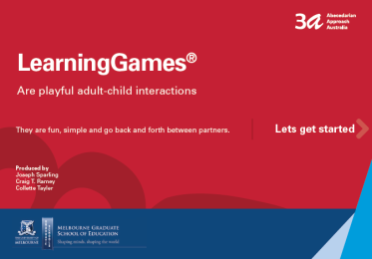
Enriched Caregiving
While You Wait: A-Bouncing We Will Go
(Tune: The Farmer in the Dell)
A-bouncing we will go
A-bouncing we will go
High, low, and to and fro
A-bouncing we will go
Additional verses:
a-swaying
a-flying
a-cuddling
Download at:
3a.education.unimelb.edu.au

Slide 24
Waiting at Airports and On Planes
All of these rhymes and songs we’ve sung today would be great for the long, long wait for an airplane to land!
Here’s another bumpy one, that might be useful for preparing bubby for the concept of turbulence.

Slide 25


Slide 26
Enriched Caregiving
While You Wait: A Smooth Road
We’re going down a smooth road
A smooth road, a smooth road x2
We’re going down a rough road
A rough road, a rough road x2
We’ve going down a bumpy road
A bumpy road, a bumpy road x2
A pothole!
Download at:
3a.education.unimelb.edu.au

Slide 27
Waiting for Coffee/One, Two, Three
We just want to wait for our take-away coffee without disturbing these other people at the café!
Here’s a fun rhyme, with potential to add other animals, to extend it.
Don’t miss the opportunity to do the animal sounds!
One, Two, Three in Baby Games: The Joyful Guide to Child’s Play from Birth to Three Years by Elaine Martin, p.35.

Slide 28


Slide 29
One, Two, Three
One, two, three (bounce)
Baby on my knee
Rooster crows (cock-a-doodle-doooo!)
And away s/he goes! (dip or lift on ‘goes’)
Make up different versions:
Lion roars and away s/he soars!
Parrot squawks and away s/he walks!

Slide 30
3a LearningGames and Play
Songs and games based on 3a LearningGames™ and other developmentally supportive activities, like tummy time.
A focus on integrating parent awareness of developmental needs/milestones, both physical and cognitive/social/emotional.
Similar to Toddlertime activities, but with an even greater focus on hands-on parent engagement with baby (toddlers can begin to carry out more purposeful actions, and can therefore undertake more independent tasks).
Take the evidence-based principles of the 3a LearningGames™, and adapt them to our typical library program toys and props, most of which are profiled for all developmental and linguistic benefits on Playgroup WA’s Play Ideas page:
  Parachute
  Balls
  Egg shakers
  Instruments
  Cardboard tubes
  Bubbles
  Bean bags
  Ribbons / Scarves
  Foam blocks
  Tape rolls
  Feathers
  Puppets
  Mirrors
  Toys/rattles ideal for babies’ grip
  Giant scrunchies
  Etc
Book resource recommendations:
  The Creative Curriculum Learning Games birth-12 months
  The Creative Curriculum Learning Games 12-24 months
  Moving to Learn by Robyn Crowe and Gill Connell
  Brain Games for Babies, Toddlers and Twos by Jackie Silberg
  Baby Games: The Joyful Guide to Child’s Play from Birth to Three Years by Elaine Martin
  Baby’s First Skills by Miriam Stoppard
Make sure you critically match up your activity level with knowledge of the developmental milestones and pathways.
Watch some videos of this Babytime model in action.
Watch some videos of these props and toys in action with various ages.
THIS WEEK: Compare and Contrast Musical Games
Different types of sounds, pitches, rhythms, musical patterns.

Slide 31
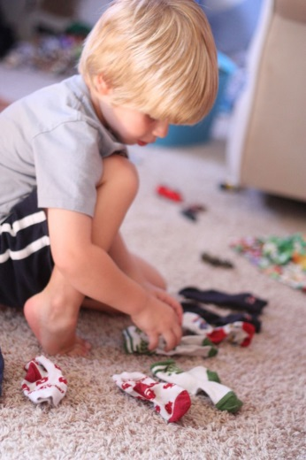
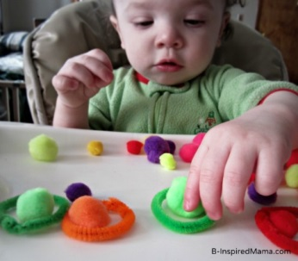
Learning Games: Matching Sounds
https://au.pinterest.com/pin/88031367690766557
Download at:
3a.education.unimelb.edu.au
https://www.tes.com/lessons/vOEaGmv15_isAw/promoting-children-s-development-sensory-play

Slide 32
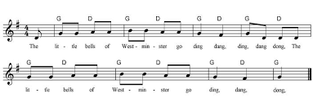
The Little Bells of Westminster
Sing one song different ways. Tap on baby to beat. Normal, then low, high, whispering, humming/la la la, clapping the melody. Give baby’s brain an explosion of pattern to notice and learn from. "The more ways your baby hears this song, the more she will try to copy you and develop her language skills." Brain Games for Babies, Toddlers and Twos by Jackie Silberg, p.68.

Slide 33
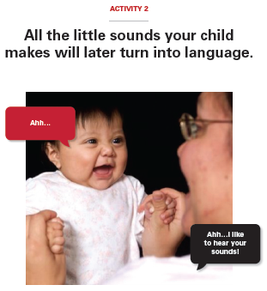
The Little Bells of Westminster
The little bells of Westminster go ding, dong, ding, dong, dong
The little bells of Westminster go ding, dong, ding
Normal
Low
High
Whispering
Humming/la la la
Clapping the melody
Try others: quacking! Mooing!
Funny accents or voices!
Download at:
3a.education.unimelb.edu.au

Slide 34
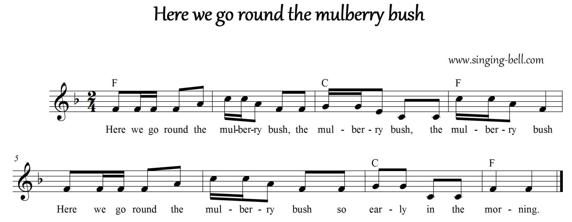
This Is The Way We Tap the Beat
1. Tap the beat on baby’s body while singing twice:
1 2 3 4
This is the way we tap the beat
2. Tap the triplets while singing twice.
1 2 3 1 2 3 1 2 3 1 2 3
This is the way we tap the thirds
3. Tap for every note/syllable that you sing.
D
A
D
A
D

Slide 35
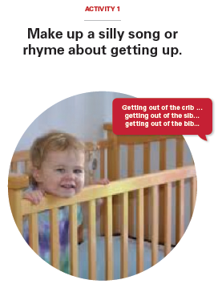
This is the Way We Tap the Beat
This is the way we tap the beat
Tap the beat, tap the beat
This is the way we tap the beat
On a cold and frosty morning
This is the way we tap the thirds…
This is the way we tap the tune…
Download at:
3a.education.unimelb.edu.au

Slide 36
Dance/Movement: Carers on feet, holding baby
An activity designed to encourage carers’ whole-bodied engagement, and bonding with baby.
Establishes active, fun habits for both the adults’ and kids’ health.
Works on carers’ and babies’ sense of rhythm awareness, balance, and much more.
Opportunity to incorporate adult/pop songs and culturally traditional tunes/family anthems.
Music Together® is the best model I have ever seen of group facilitation methods that establish safety and buy-in from parents in potentially intimidating and nerve-racking exercises like this. I cannot recommend their training highly enough for any early years practitioners working with both parents and children at the same time (even if you don’t do a lot of music). Even if this segment, for you as a facilitator, is more rhyme-based, rather than music based, or if you are more of a sports person than an arts person, the value in Music Together is how to facilitate multi-generational groups by leading with the body and behaviour.

Slide 37
Flying Babies (Let’s Go Fly a Kite)
Buy an mp3 on iTunes or Google Play to embed in the PowerPoint (can be trimmed for length), or place a link on the public slide to a YouTube rendition.
You could use other similar songs for the same effect. Swinging (Justine Clarke). I Believe I Can Fly. Fly Me To the Moon (Sinatra). (For this last song, you could alternatively teach them to foxtrot with baby! The stepping pattern is slow, slow, quick-quick, slow, slow, quick-quick…)
Words/concepts to stimulate babies and carers’ movements: over mountain, down through valley, circle the runway, turbulence, dodge other planes. Make airplane noises. Loops, rolls, spins, stall. Take off. Landing.

Slide 38

Let’s Go Fly A Kite (Mary Poppins)

Slide 39
Conversational Reading module (3a)
Once every family has a copy to share with their caregiver, facilitator to sit down with their “baby” doll and model sitting and book opening.
Signal the beginning of choral read by singing ‘Now It’s Time To Read a Book’ (set song) to the tune of ‘London Bridge Is Falling Down’:
  Now it’s time to read a book
  Read a book, read a book
  Now it’s time to read a book
  Let’s read abook together
Facilitator to give examples of conversational opportunities from page to page, and encourage carers to follow baby’s gaze and discuss what they’re looking at.
Aimed at carer practice/rehearsal for home reading first, which then increases the chances of baby’s in-session (and general) engagement. Dissect/demystify the process for them and give them tools for home.

Slide 40
Read Aloud Story
SEE: Watch your baby’s eyes, and name what they see or touch. Say the key word first. Then, point to and name things your child is not looking at. Point to lots of pictures, and say interesting things about them.
SHOW: Let your child’s eyes, hands and actions show their understanding. “Where is the flower? Yes, you showed me!” Ask your child to “show” in interesting ways: “Put your finger under the dog. Tickle the monkey’s toes. Cover the man’s hat.” Ask them to “show” with actions: “How does the kangaroo move? How do people clap their hands?”
SAY: Invite your child to “say”—to answer in words. How? Who? When? Where? Why? What? “What is the cow doing?” “Eating grass!” Leave a word out and let the child supply it: “The duck said…”
Conversational Reading
Think of the 3Ss as steps upwards in literacy:

Slide 41
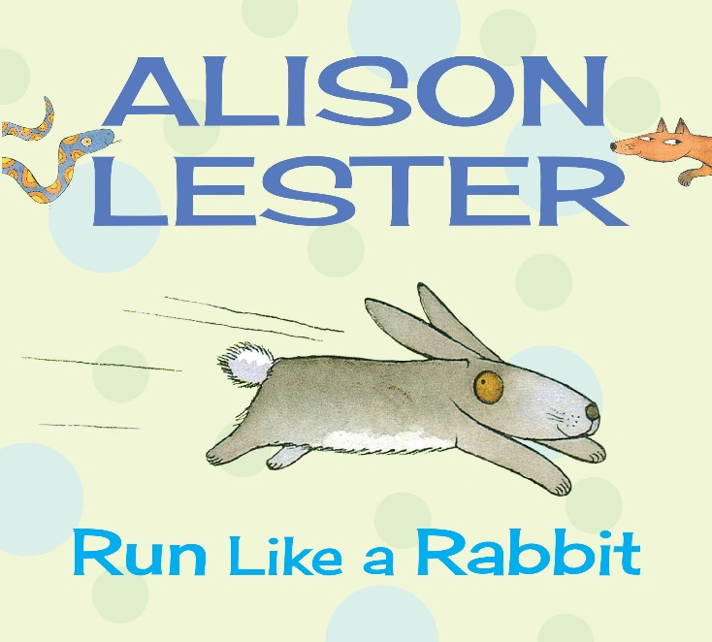
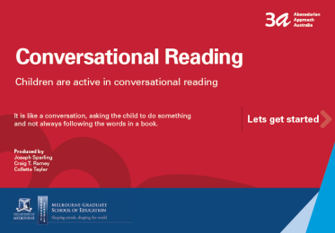
Now it’s Time to Read a Book
(Tune: London Bridge Is Falling Down)
Now it’s time to read a book
Read a book, read a book
Now it’s time to read a book
Let’s read a book together
Download at:
3a.education.unimelb.edu.au
Notes:
Movement Song
Standing

Slide 42
Lullaby
Nurturing Wellbeing with Nightly Bedtime Music
Setting up a bedtime routine for families (read a book, ie as above) and then complete ritual with lullaby and bonding.
Opportunity to wind down from session, to tap/rock baby in rhythm to work on music awareness, to create a habit that lowers stress/cortisol, and to broaden carers’ lullaby vocabulary.

Slide 43
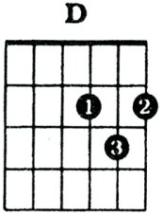
Lullaby: The Lion Sleeps Tonight
[A] In the jungle, the [D] mighty jungle
The [A] lion sleeps to- [E] night
Repeat chords throughout.

Slide 44
Lullaby: The Lion Sleeps Tonight
In the jungle, the mighty jungle
The lion sleeps tonight x2
Wee-ee-ee-ee-ee um-um-a-way
Near the village, the peaceful village…
Hush my darling, don’t fear my darling…

Slide 45
Session Close: Goodbye Song
Inform the carers that the session is coming to a close and impart any relevant Library news (e.g. special event coming up, new collection items, school holiday information, upcoming public holiday, etc).
Use a core goodbye song (here's a playlist) as a clear signal the session is ending, to model establishing routines for carers, and support babies’ acclimatisation to the ritual of library sessions.

Slide 46
Closing Song
Tune: Skip To My Lou. YouTube: https://youtu.be/LgQXhs9BWt8
[A] Clap, clap, clap you hands
[E] Clap, clap, clap you hands
[A] Clap, clap, clap you hands
[E] Clap your hands to- [A] gether
Repeat chord pattern throughout
Underline = introduction

Slide 47

Closing Song: Clap, Clap, Clap Your Hands
(Tune: Skip to My Lou)
Clap, clap, clap your hands (x3)
Clap your hands together
2. Roll, roll, roll your hands…
3. Wriggle, wriggle, wriggle your hands…
4. Give, give, give a hug…
5. Blow, blow, blow a kiss…
6. Wave, wave, wave goodbye...

Slide 48
Baby Bounce Playgroup
Set up selection of activities, tied into the session’s focus if desired (but not necessary), that encourage families to remain and socialise.
Gives formal structure to social time, aiming to reduce in-session chatting.
Models age-appropriate activities for home use, and provides opportunities for engagement with resources the family may not have access to.
Provides opportunity for language priority/vocabulary development through carer-mediated engagement with activities for baby.
See 3a LearningGames books for prop ideas, plus Playgroup WA’s Play Ideas page.

Slide 49

Baby Bounce Playgroup:
Please stay to play, chat and get to know one another!
Photograph link for later:
3a.education.unimelb.edu.au

