Slide 1
2001 Songs of the Month
January - Five Coyotes
February - Valentines Song
March - Fuzzy Slippers
April - The Flower Song
May - Let's Go To The Market
June - Scallop Song
July - Hee Na Nee Na
August - Little Cat
September - Listen to the Drum
October - Nocturnal Animals
November - Our Thanksgiving Day
December - Ramadan

Slide 2
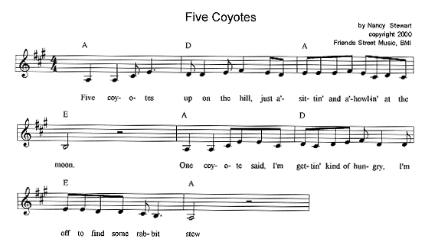
Five Coyotes http://www.nancymusic.com/Coyotes.htm
Coyote and rabbit templates http://www.nancymusic.com/Coyotesplay.htm

Slide 3
Five Coyotes (Nancy Stewart)
Five coyotes up on the hill
Just a sittin’ and a howlin’ at the moon One coyote said, "I’m gettin’ kinda hungry, I’m off to find some rabbit stew!" (Repeat with four, three, two and one) Then down in the valley five little rabbits Hop into a hole in the ground
They said, "we hear the coyotes are gettin’ kinda hungry, And we don’t plan to be around"
Visit www.nancymusic.com
to download this FREE
children’s song at home!

Slide 4
Five Coyotes (Nancy Stewart)
Five coyotes up on the hill
Just a sittin’ and a howlin’ at the moon One coyote said, "I’m gettin’ kinda hungry, I’m off to find some rabbit stew!" (Repeat with four, three, two and one) Then down in the valley five little rabbits Hop into a hole in the ground
They said, "we hear the coyotes are gettin’ kinda hungry, And we don’t plan to be around"
Visit www.nancymusic.com
to download this FREE
children’s song at home!

Slide 5
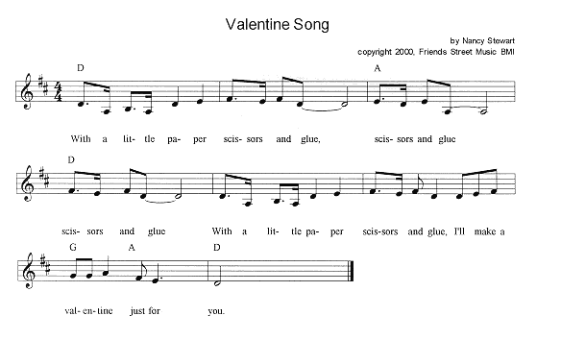
Valentine Song http://www.nancymusic.com/Valentines.htm
Fingerplay actions: http://www.nancymusic.com/Valentinesplay.htm

Slide 6
Valentine Song (Nancy Stewart)
With a little paper, scissors and glue scissors and glue scissors and glue With a little paper, scissors and glue I'll make a Valentine just for you First I'm gonna draw a big red heart a big red heart a big red heart First I'm gonna draw a big red heart To make a Valentine just for you I'll take a pair of scissors and I'll cut it out I'll cut it out I'll cut it out I'll take a pair of scissors and I'll cut it out To make a Valentine just for you I'll take a little glue and I'll stick it down I'll stick it down I'll stick it down I'll take a little glue and I'll stick it down To make a Valentine just for you Then when you open it you will see You will see You will see How well I can cut and draw and glue To make a Valentine just for you Gonna make a Valentine just for you
Visit www.nancymusic.com
to download this FREE
children’s song at home!

Slide 7
Valentine Song (Nancy Stewart)
With a little paper, scissors and glue scissors and glue scissors and glue With a little paper, scissors and glue I'll make a Valentine just for you First I'm gonna draw a big red heart a big red heart a big red heart First I'm gonna draw a big red heart To make a Valentine just for you I'll take a pair of scissors and I'll cut it out I'll cut it out I'll cut it out I'll take a pair of scissors and I'll cut it out To make a Valentine just for you I'll take a little glue and I'll stick it down I'll stick it down I'll stick it down I'll take a little glue and I'll stick it down To make a Valentine just for you Then when you open it you will see You will see You will see How well I can cut and draw and glue To make a Valentine just for you Gonna make a Valentine just for you
Visit www.nancymusic.com
to download this FREE
children’s song at home!

Slide 8
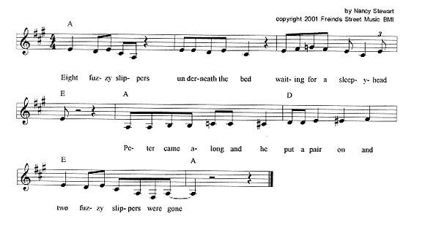
Fuzzy Slippers http://www.nancymusic.com/Fuzzy.htm
Fuzzy Slippers activity ideas: http://www.nancymusic.com/Fuzzyplay.htm

Slide 9
Fuzzy Slippers (Nancy Stewart)
Eight fuzzy slippers underneath the bed
Waiting for a sleepyhead
Peter came along and he put a pair on
And two fuzzy slippers were gone
Six… Suzy…
Four… Johnny…
Two… Betty came along and she put a pair on
And two fuzzy slippers
A pair of fuzzy slippers
All the fuzzy slippers were gone
Visit www.nancymusic.com
to download this FREE
children’s song at home!

Slide 10
Fuzzy Slippers (Nancy Stewart)
Eight fuzzy slippers underneath the bed
Waiting for a sleepyhead
Peter came along and he put a pair on
And two fuzzy slippers were gone
Six… Suzy…
Four… Johnny…
Two… Betty came along and she put a pair on
And two fuzzy slippers
A pair of fuzzy slippers
All the fuzzy slippers were gone
Visit www.nancymusic.com
to download this FREE
children’s song at home!

Slide 11
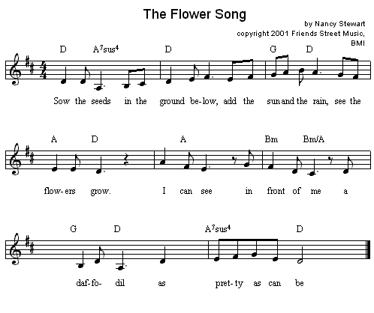
The Flower Song http://www.nancymusic.com/Flower.htm
Activity ideas and actions to accompany the song: http://www.nancymusic.com/Flowerplay.htm

Slide 12
The Flower Song (Nancy Stewart)
Sow the seeds in the ground below Add the sun and the rain See the flowers grow I can see in front of me A daffodil as pretty as can be
Sow the seeds…
A yellow rose as pretty as can be
A tulip just as pretty as can be
A iris just as pretty as can be
Visit www.nancymusic.com
to download this FREE
children’s song at home!

Slide 13
The Flower Song (Nancy Stewart)
Sow the seeds in the ground below Add the sun and the rain See the flowers grow I can see in front of me A daffodil as pretty as can be
Sow the seeds…
A yellow rose as pretty as can be
A tulip just as pretty as can be
A iris just as pretty as can be
Visit www.nancymusic.com
to download this FREE
children’s song at home!

Slide 14
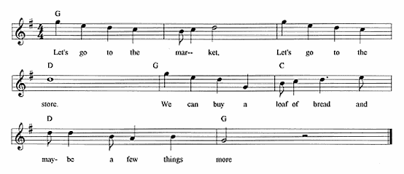
Let’s Go to the Market http://www.nancymusic.com/Market.htm
Activity instructions: http://www.nancymusic.com/Marketplay.htm

Slide 15
Let’s Go to the Market (Nancy Stewart)
Let’s go to the market, let’s go to the store We can buy a loaf of bread, and maybe a few things more
We can buy:
some broccoli
some cereal
some bananas
some orange juice
Visit www.nancymusic.com
to download this FREE
children’s song at home!

Slide 16
Let’s Go to the Market (Nancy Stewart)
Let’s go to the market, let’s go to the store We can buy a loaf of bread, and maybe a few things more
We can buy:
some broccoli
some cereal
some bananas
some orange juice
Visit www.nancymusic.com
to download this FREE
children’s song at home!

Slide 17
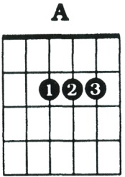
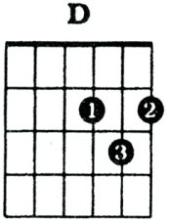
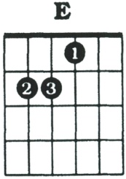
I’m a Little Scallop http://www.nancymusic.com/Scallop.htm
[A] I’m a little scallop [D] in a [A] shell
[E] Down in the [A] sand I [E] live quite [A] well
[A] But if you come a knockin’ [D] at my [A] door
[A] I’ll close up [D] tight, you won’t [A] see me [E] any [A] more
(Play underlined phrase as introduction to song.)

Slide 18
I’m a Little Scallop (Nancy Stewart)
(Tune: I’m a Little Teapot)
I’m a little scallop in a shell
Down in the sand I live quite well
But if you come a knockin’ at my door
I’ll close up tight, you won’t see me anymore!
Visit www.nancymusic.com
to download this FREE
children’s song at home!

Slide 19
I’m a Little Scallop (Nancy Stewart)
(Tune: I’m a Little Teapot)
I’m a little scallop in a shell
Down in the sand I live quite well
But if you come a knockin’ at my door
I’ll close up tight, you won’t see me anymore!
Visit www.nancymusic.com
to download this FREE
children’s song at home!

Slide 20
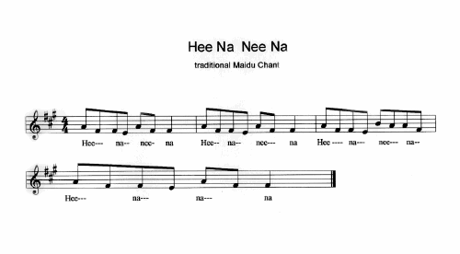
Hee Na Nee Na
http://www.nancymusic.com/HeeNa.htm

Slide 21
Hee Na Nee Na
This traditional chant comes from the Maidu tribe of Native American, which lived in the Sierra Nevada mountains during the California Gold Era. Children play a game while singing the chant: Hee Na Nee Na (sung 4 times) Hold a treasure (a coin works well ) in one hand, covered by the other. Turn closed hands over, back and forth, while singing the chant. At the end separate hands into fists, and have the rest of the children guess which fist holds the treasure. Let children take turns trying to “trick” each other.
Visit www.nancymusic.com
to download this FREE
children’s song at home!

Slide 22
Hee Na Nee Na
This traditional chant comes from the Maidu tribe of Native American, which lived in the Sierra Nevada mountains during the California Gold Era. Children play a game while singing the chant: Hee Na Nee Na (sung 4 times) Hold a treasure (a coin works well ) in one hand, covered by the other. Turn closed hands over, back and forth, while singing the chant. At the end separate hands into fists, and have the rest of the children guess which fist holds the treasure. Let children take turns trying to “trick” each other.
Visit www.nancymusic.com
to download this FREE
children’s song at home!

Slide 23
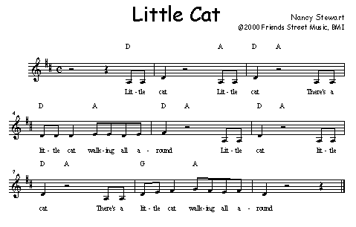
Little Cat http://www.nancymusic.com/Littlecat.htm
Instructions and resources: http://www.nancymusic.com/little-cat.pdf

Slide 24
Little Cat (Nancy Stewart)
Little cat (meow), little cat (meow) There’s a little cat walking all around Little cat (meow), little cat (meow) There’s a little cat walking all around
duck
pig
mouse
Visit www.nancymusic.com
to download this FREE
children’s song at home!

Slide 25
Little Cat (Nancy Stewart)
Little cat (meow), little cat (meow) There’s a little cat walking all around Little cat (meow), little cat (meow) There’s a little cat walking all around
duck
pig
mouse
Visit www.nancymusic.com
to download this FREE
children’s song at home!

Slide 26
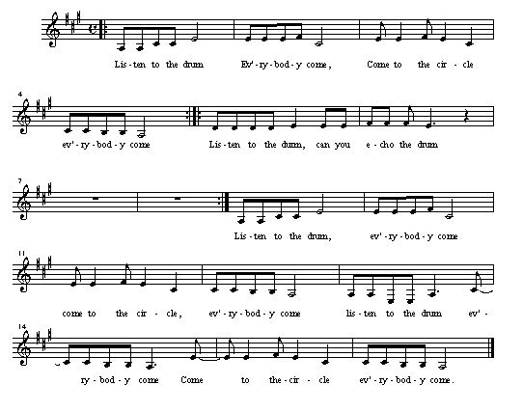
Listen to the Drum
Use this song to teach listening skills, rhythm, following directions, and communicating without words!
http://www.nancymusic.com/Drum.htm

Slide 27
Listen to the Drum
Listen to the drum, everybody come
Come to the circle, everybody come (repeat)
Listen to the drum, can you echo the drum (play a pattern, let children echo)
(repeat)
Listen to the drum, everybody come
Come to the circle, everybody come
Listen to the drum everybody come
Come to the circle, everybody come
Visit www.nancymusic.com
to download this FREE
children’s song at home!

Slide 28
Listen to the Drum
Listen to the drum, everybody come
Come to the circle, everybody come (repeat)
Listen to the drum, can you echo the drum (play a pattern, let children echo)
(repeat)
Listen to the drum, everybody come
Come to the circle, everybody come
Listen to the drum everybody come
Come to the circle, everybody come
Visit www.nancymusic.com
to download this FREE
children’s song at home!

Slide 29
Nocturnal Animals
Instructions: http://www.nancymusic.com/Nocturnal.htm

Slide 30
Nocturnal Animals
On a moonlit night when the stars come out There are nocturnal animals all about
1. Whoo, whoo, what do I see (make circles with fingers, hold up to eyes) A wise old owl looking at me
Meow, meow, what do I see A big black cat is looking at me
Eee, eee, eee, what do I see A little bat just looking at me
Ribbit, ribbit, what do I see A big green tree frog looking at me
Squeak, squeak, squeak, what do I see A garden dormouse looking at me
Visit www.nancymusic.com
to download this FREE
children’s song at home!

Slide 31
Nocturnal Animals
On a moonlit night when the stars come out There are nocturnal animals all about
1. Whoo, whoo, what do I see (make circles with fingers, hold up to eyes) A wise old owl looking at me
Meow, meow, what do I see A big black cat is looking at me
Eee, eee, eee, what do I see A little bat just looking at me
Ribbit, ribbit, what do I see A big green tree frog looking at me
Squeak, squeak, squeak, what do I see A garden dormouse looking at me
Visit www.nancymusic.com
to download this FREE
children’s song at home!

Slide 32
Our Thanksgiving Day http://www.nancymusic.com/Tday.htm
Play ideas: http://www.nancymusic.com/Tdayplay.htm

Slide 33
Our Thanksgiving Day
We can work together (x3) for our Thanksgiving Day
You can cook the turkey (x3) for our Thanksgiving Day
I can mash potatoes (x3) for our Thanksgiving Day
We can make an apple pie We can make a cherry pie We can make a pumpkin pie for our Thanksgiving Day
We can set the table (x3) for our Thanksgiving Day
We'll join our hands together (x3) for our Thanksgiving Day
We can all say thank you (x3) for our Thanksgiving Day
Optional lyrics: Thank you for (my family, our neighbours, etc) (x3) On this Thanksgiving Day
Visit www.nancymusic.com
to download this FREE
children’s song at home!

Slide 34
Our Thanksgiving Day
We can work together (x3) for our Thanksgiving Day
You can cook the turkey (x3) for our Thanksgiving Day
I can mash potatoes (x3) for our Thanksgiving Day
We can make an apple pie We can make a cherry pie We can make a pumpkin pie for our Thanksgiving Day
We can set the table (x3) for our Thanksgiving Day
We'll join our hands together (x3) for our Thanksgiving Day
We can all say thank you (x3) for our Thanksgiving Day
Optional lyrics: Thank you for (my family, our neighbours, etc) (x3) On this Thanksgiving Day
Visit www.nancymusic.com
to download this FREE
children’s song at home!

Slide 35
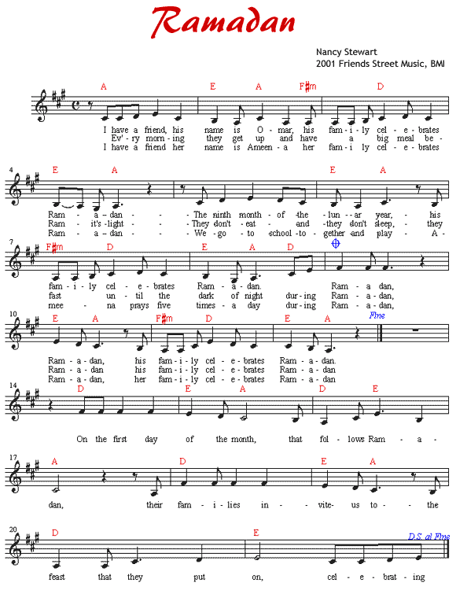
Ramadan
Instructions, resources, instrumental only recording: http://www.nancymusic.com/Ramadan.htm

Slide 36
Ramadan
I have a friend, his name is Omar His family celebrates Ramadan The ninth month of the lunar year His family celebrates Ramadan
Chorus: Ramadan, Ramadan His family celebrates Ramadan
Every morning they get up And have a big meal before the light Then they don’t eat, and they don’t drink They fast until the dark of night (chorus)
I have a friend, her name is Ameena Her family celebrates Ramadan We go to school together and play Ameena prays five times a day, during (chorus)
On the first day of the month that follows Ramadan Their families invite us to the feast that they put on Celebrating (chorus)
Ramadan Mubarak (have a blessed Ramadan) Ramadan
Visit www.nancymusic.com
to download this FREE
children’s song at home!

Slide 37
Ramadan
I have a friend, his name is Omar His family celebrates Ramadan The ninth month of the lunar year His family celebrates Ramadan
Chorus: Ramadan, Ramadan His family celebrates Ramadan
Every morning they get up And have a big meal before the light Then they don’t eat, and they don’t drink They fast until the dark of night (chorus)
I have a friend, her name is Ameena Her family celebrates Ramadan We go to school together and play Ameena prays five times a day, during (chorus)
On the first day of the month that follows Ramadan Their families invite us to the feast that they put on Celebrating (chorus)
Ramadan Mubarak (have a blessed Ramadan) Ramadan
Visit www.nancymusic.com
to download this FREE
children’s song at home!

